Slide 1
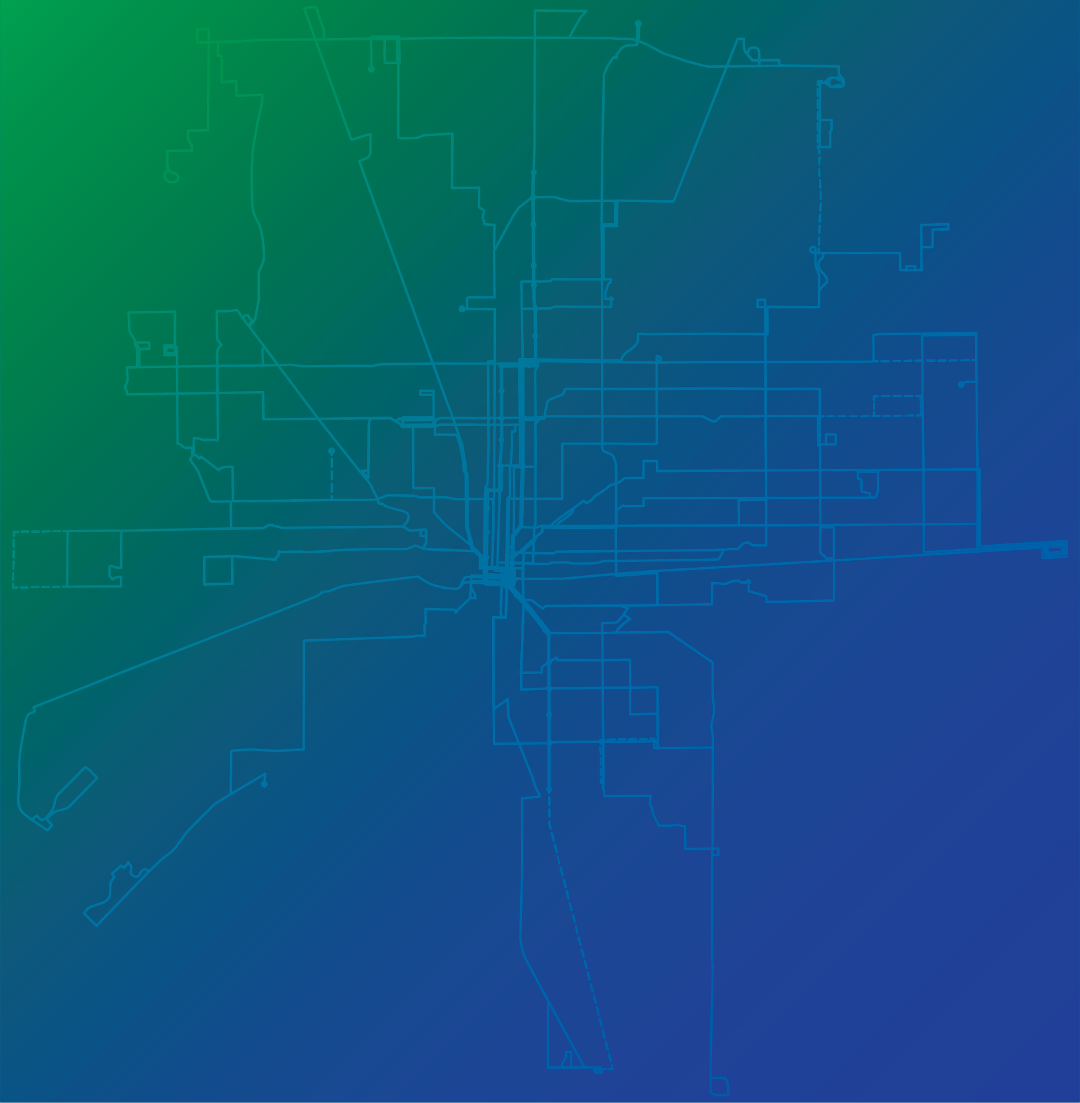

FARE POLICY
PROPOSAL
TITLE
HERE HERE
TITLE
MAY 2025
Notes:
IndyGo leadership brought forth a recommendation in May to adopt a new fare policy that includes a single increase in the base fare from $1.75 to $2.75​
Adjusting the price of other fare products accordingly—with an effective date of January 1, 2026, if approved by the Board of Directors. ​
This is the result of year-long process of reviewing and analyzing our current fare policy that was put in place in 2019.​

Slide 2
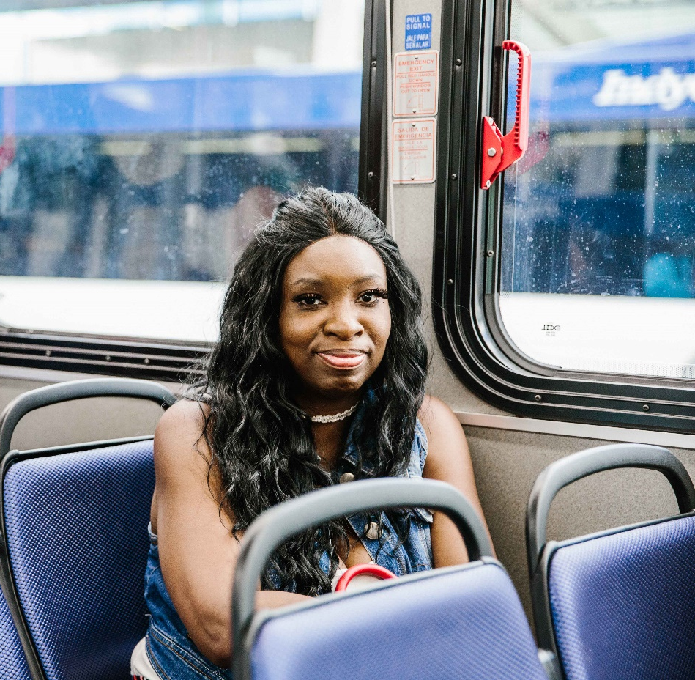
FARE POLICY UPDATE
IndyGo’s purchasing power has declined and expenses are up.
15+ years since the last increase
The purchasing power of $1.75 is 67% of what it was in 2009
58% increase in operating expenses/vehicle revenue hour from
$105 (2013) to $180 (2023)
$1.75 in January 2009 = $2.61 today
Notes:
IndyGo has not adjusted its fixed-route base fare in more than 15 years.
The effects of inflation have eroded the value of the fare revenue IndyGo does receive at the same time IndyGo’s operating expenses—resulting from changes to the collective-bargaining agreement, improvements to local bus routes and the launching of BRT services—have increased considerably.​
Our operating expenses per vehicle revenue hour have increased nearly 60% from $105 per hour to $180 per hour for local fixed route only.
Operating expenses include everything it costs to run service, including fuel and labor costs.
Given the impact of inflation, as of August 2024, the purchasing power of today’s base fare is 67 percent of what it was when it was last raised in 2009.
To achieve parity with the purchasing power of the $1.75 in January 2009, today’s fare would need to be $2.61.

Slide 3
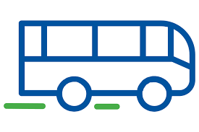
FARE POLICY UPDATE
Not every rider pays full fare, or even half fare.
Federally Required to Provide
Persons 65+ w/a Medicare Card (half fare)
Persons w/a Disability (half fare)
Not Federally Required to Provide
Veterans (fare free)
Government Employees (fare free or half fare)
Student Sponsored Rides (fare free)
Persons 18 or younger (half fare)
Children under 5 (fare free)
IndyGo Foundation nonprofit partners (reduced fare)
IndyGo employees & dependents (fare free)
IndyGo retirees (fare free)
IndyGo Access customers (half fare)
Notes:
Please be clear that free to an individual doesn’t mean no revenue to the agency (some free fares are covered by third-party payers)
Veterans – because veterans are required to obtain and use a personalized MyKey card to ride fare free, we can share that there are more than 10,500 eligible veterans with these cards today.​
Students – students include youth who are eligible to ride at the half-fare rate under our existing fare policy and students include area high schoolers who are riding at no direct cost to them or their families because they are enrolled at a school that pays us a program participation fee for those students, which is approximately 2,000 students from the following schools: Purdue Polytechnic High School, Herron Classical Schools, Indianapolis Metropolitan, Believe Circle City Schools, and IPS. Schools also buy passes in bulk to have on hand to give to students.​
Government employees – Most of these trips are taken using passes that are purchased in bulk. The pass types vary, but the total number of half-fare passes purchased by such entities as the City of Indianapolis and the Indiana Dept of Child Services in 2024 is well over 15,000.
IndyGo Retirees employees – This is limited to less than 40 people.​
Riders who qualify for passes through federal mandate – Our most recent onboard survey is the best source of information aimed at this grouping. That report is available here: https://www.indygo.net/about-indygo/transit-planning

Slide 4
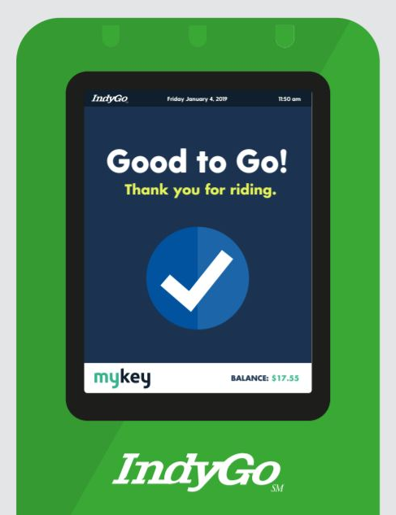
FARE POLICY UPDATE
Not every trip is a paid trip for those who do pay full fare.
E-fare = Automatic Best Value
Pay-as-you-go (carry a balance)
Balance protection
Pay no more than $4.00 for the day, or $15.75 for the week
Receive a deposit bonus of $1, $2, or $3
Notes:
With the adoption of the 2019 Fare Policy, IndyGo created a benefit for riders through which—carrying a balance on and using a MyKey media account—passengers could pay as they go and spend toward a daily and/or weekly maximum fare amount rather than having to pay for the total cost of a paper period pass up front.
This practice, known as fare capping, is viewed as a more equitable approach to fare payment. Riders simply ride the bus as they otherwise would and are no longer charged –or have to carry a balance—once they hit the cap for a given day or (transit) week.

Slide 5
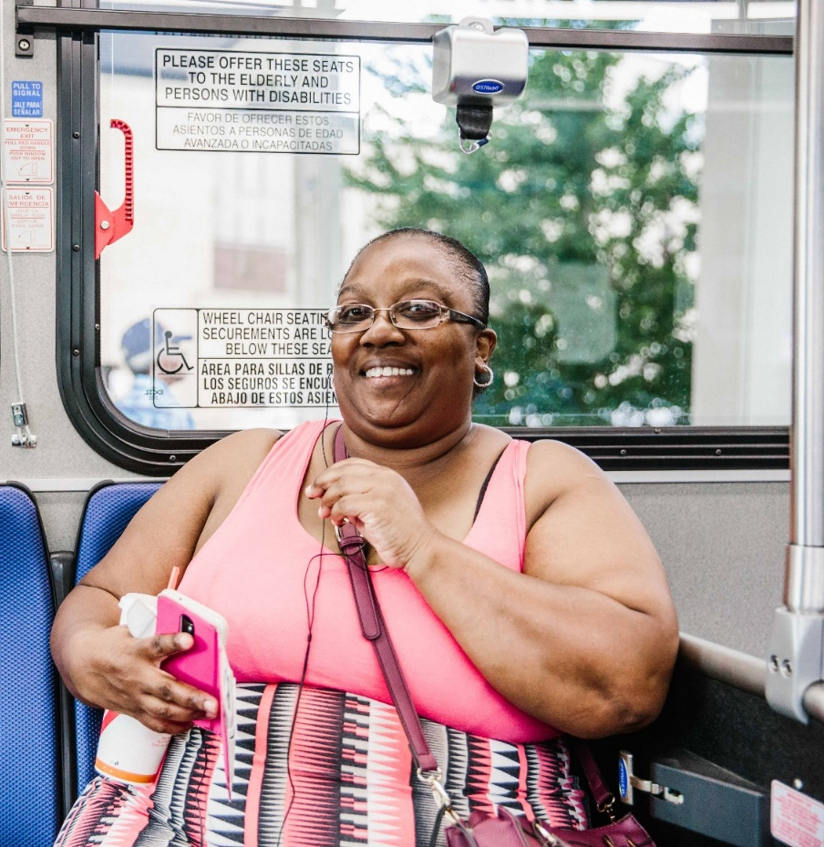
FARE POLICY UPDATE
Who are IndyGo’s riders?
African American Woman
Age 35-49
Is employed but likely has a household income of less than $25,000 per year.
There is no vehicle available to her.
She uses cash on the bus and walks less than 1/4 miles to and from the bus stop.
She only takes one bus to arrive at her destination.
She uses the bus 5 days a week to travel between home and work.
76% Employed | 57% Zero Car Households | 71% Households Earning < $35,000/year |
44% Report Incomes That Meet our Low-Income Threshold
Notes:
71 percent of households report earning less than $35,000/yr​
44 percent of IndyGo riders report incomes that would meet IndyGo’s Title VI threshold for being considered low-income​

Slide 6
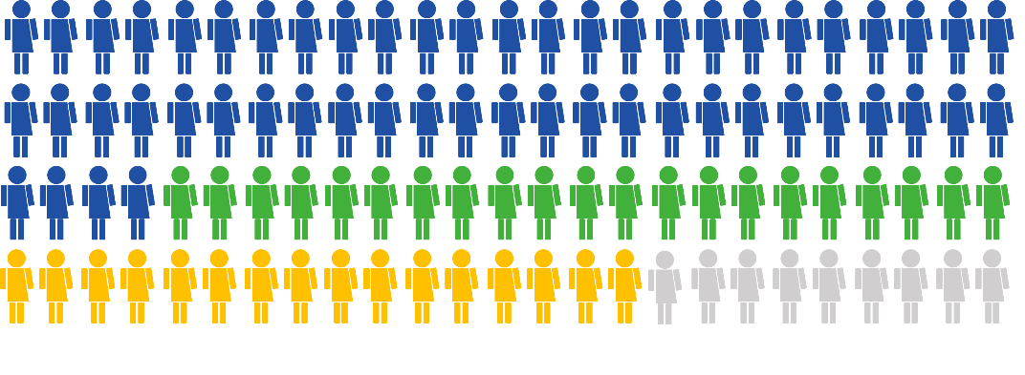
FARE POLICY UPDATE
How do IndyGo’s riders pay for their bus fare?
54% use cash on the bus (35% use 1-trip, 19% use day pass)
21% use MyKey (17% use tap card, 4% mobile app)
16% use a 31-day pass
8% use another payment method (e.g., S-pass)

Slide 7
FARE POLICY UPDATE
How much does the typical IndyGo rider pay to ride? $1.10/trip
Example: Trip-by-Trip, Cash on the Bus @$1.75
Trips | M | T | W | R | F | S | S
AM Commute | $1.75 | $1.75 | $1.75 | $1.75 | $1.75 | - | -
Free Transfer | $0.00 | $0.00 | $0.00 | $0.00 | $0.00 | - | -
PM Commute | $1.75 | $1.75 | $1.75 | $1.75 | $1.75 | - | -
Free Transfer | $0.00 | $0.00 | $0.00 | $0.00 | $0.00 | - | -
Leisure Trip(s) | - | $1.75 | - | $1.75 | $1.75 | $3.50 | $3.50
Effective Daily Max. | $3.50 | $5.25 | $3.50 | $5.25 | $5.25 | $3.50 | $3.50
Cumulative Total | $3.50 | $8.75 | $12.25 | $17.50 | $22.75 | $26.25 | $29.75 ($1.10/trip)
Notes:
Our typical IndyGo rider relies on IndyGo to get to work, Mon-Fri.​
She requires two buses, a 2-seat ride, to get to work and back, and makes use of our policy to allow free transfers between buses for up to two hours from purchasing her fare​
The point being - even those that pay the full fare to ride receive fare free rides under IndyGo’s current fare policy.​
Green star represents fare free trips.
In this example, we’ve assumed that she knows to ask for a 2-hr transfer ticket, or if she doesn’t, that the bus drivers are automatically printing them off and handing them to her. ​
If not, her total out-of-pocket costs for the week would be even higher.

Slide 8
FARE POLICY UPDATE
Fixed Route Fare Rate Adjustments
Fare Type | Current |  | Proposed
 | Full Fare | Half Fare | Full Fare | Half Fare
2-hour unlimited | $1.75 | $0.85 | $2.75 | $1.35
1-day | $4.00 | $2.00 | $6.00 | $3.00
1-week | $15.75 | $7.65 | $24.75 | $12.15
Eliminate the $2 issuance fee for MyKey cards
Notes:
IndyGo’s 2019 Fare Policy update maintained the agency’s base fare rate at $1.75 and thus held the half-fare ($0.85) and paratransit fare ($3.50) constant as well.
On Jan 1, 2023, we eliminated fare free rides on fixed route transit for IndyGo’s eligible paratransit riders; they, instead, pay the half-fare rate.
The adopted fare policy introduced daily and weekly fare capping, provided free 2-hr transfers, and established policies to govern the use of IndyGo’s new account-based ticketing system.

Slide 9
FARE POLICY UPDATE
Retirement of outdated fare passes
Sales End July 1, 2026
10-Trip
31-Day
S-Pass
Summer Youth Pass
No Longer Accepted July 1, 2027
7-Day
10-Trip
31-Day
S-Pass
Summer Youth Pass

Slide 10
FARE POLICY UPDATE
How much could the typical IndyGo rider pay to ride? $.92/trip
Example: Pay-as-you-go, Automatic Best Value @$2.75
Trips | M | T | W | R | F | S | S
AM Commute | $2.75 | $2.75 | $2.75 | $2.75 | $1.75 | - | -
Free Transfer | $0.00 | $0.00 | $0.00 | $0.00 | $0.00 | - | -
PM Commute | $2.75 | $2.75 | $2.75 | $2.75 | $0.00 | - | -
Free Transfer | $0.00 | $0.00 | $0.00 | $0.00 | $0.00 | - | -
1 (or more) Leisure Trips | - | $0.50 | - | $0.50 | $0.00 | $0.00 | $0.00
Effective Daily Max. | $5.50 | $6.00 | $5.50 | $6.00 | $0.75 | $0.00 | $0.00
Cumulative Total | $5.50 | $11.50 | $17.00 | $23.00 | $24.75 | $24.75 | $24.75 ($0.92/trip)
Notes:
Again, even those that pay the full fare to ride receive fare free rides under IndyGo’s current fare policy.​
In this example where the rider is using their registered MyKey card or mobile app to validate every trip​
Reach the daily fare cap on Tuesday and Thursday.​
Reach the weekly fare cap by Friday morning. ​
More fare free rides compared to someone who pays cash on the bus.​
Out of pocket cost for the week could be $24.75, rather than $29.75 (a difference of $5.00 for the week) for those that use cash on the bus​
***Even with a rate increase of $1.00, more of our riders could end up paying less to ride transit than they do today. ***

Slide 11
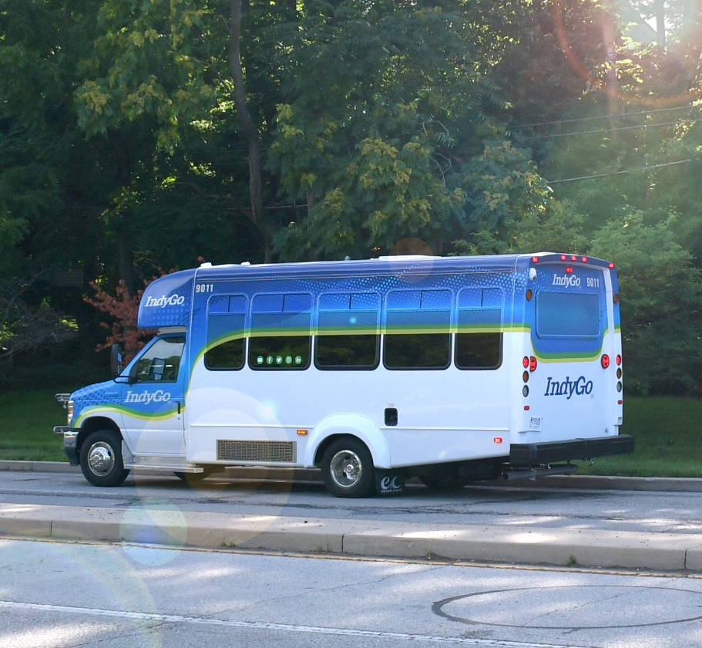
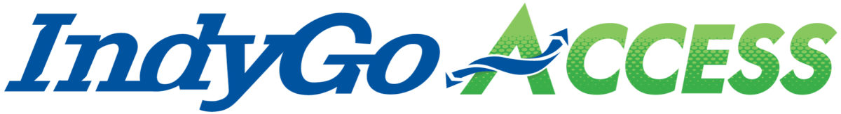
FARE POLICY UPDATE
IndyGo Access Rate Fare Adjustment
Fare Type | Current | Proposed
ADA area (2 x base fare) | $3.50 | $5.50
Premium area, scheduled (4 x base fare) | $7.00 | $11.00
Premium area, same day | $10.00 | $15.00
Notes:
IndyGo Access Fares were set by the Board of Directors when they adopted having two service areas and the exemption period.​
Cost to IndyGo is more like $60 per (one-way) trip​
The impact of paying $5.50 as opposed to $3.50 is going to vary considerably

Slide 12
FARE POLICY UPDATE
How often are eligible clients using IndyGo Access?
157,075 trips in 2024
3,000 eligible clients
687
(23%) take less than 12 trips per year
445 (15%) take less than 5 trips per month
487 (16%) take 1 to 5 trips per week
160 (<1%) take more than 5 trips per week
Notes:
Let me preface what I’m about to share by saying that we know that the numbers on this slide aren’t just numbers. ​They are people. ​And not just people but someone's mom, or dad, or sister, or daughter.​ They are some of our most valued customers – so much so that we don’t just defer to them as riders but clients​.
~3,000 eligible or ‘certified active clients’ (unique individuals)​
1,779 (59%) who took at least 1 trip in 2024 (which means 1,221, 41%, didn’t take any trips)​
1-11 trips per year = <12 trips per year (687 clients, 2024)​
<5 trips per month = 12-60 trips per year (445 clients, 2024)​
1-5 trips per week = 61 – 300 trips per year (487 clients, 2024)​
> 5 trips per week = 301-574 trips per year (160 clients, 2024)​
574, or 11 trips per week, is the greatest number of trips in 2024

Slide 13
FARE POLICY UPDATE
2025 Fare Implementation Timeline
May 15 – Introduce fare policy recommendations to IPTC Board​
June 18 – Hold public hearing during IPTC Board meeting​
July – Conclude the public outreach process​
August 21 – Vote on new Fare Policy and Fare Equity Analysis​
January 2026 – Implement new fare rates, effective 01/01/2026
Notes:
Will want to note that Fare Equity Analysis and Fare Policy will require a public hearing before IPTC Board Approval. May want to confirm with Legal if the public hearing in June would qualify. I think we should probably hold a public hearing again at approval but will want to confirm.​
Update signage on inside and outside of BRT and local buses;​
Update signage on inside and outside of paratransit vehicles (if needed);​
Program fareboxes;​
Update MyKey;​
Review and update any language at stations;​
Review and update language on the website;​
Notify Access clients about the increase (we'll have informed them earlier but we'll want a special touchpoint after too);​
Notify customers about the fare policy changes and fare increases; and ​
Push out information to the operators and dispatchers of fixed route and Access.

Slide 14

THANK
YOU
QUESTIONS?
Notes:
Quality service requires resources​
Compared to owning a personal automobile, even at $2.75 public transit is still one of the most affordable options for people.

