Slide 1






Local Government Energy Program:
Communities Sparking Investment in Transformative Energy
(C-SITE)
Funding Opportunity
'How to Apply' Webinar
May 9, 2024

Slide 2

Welcome
This webinar is being recorded and will be published on Infrastructure Exchange and program websites.
Please note that video and audio capability has been disabled for attendees.
There will be no live Q&A during today’s webinar.
For questions, please email LGEP@hq.doe.gov. All questions and answers will be posted to the Q&A Spreadsheet on the program website.
A copy of today’s slides will be posted on the program website and Infrastructure Exchange within 2-3 business days of the webinar.

Slide 3
Disclaimer
This presentation summarizes the contents of Funding Opportunity Announcement (FOA) DE-FOA-0003229. No new information other than that provided in the FOA will be discussed in the webinar.
If there are any inconsistencies between the FOA and this presentation, or statements from DOE personnel, the FOA is considered the controlling document. Applicants should rely on the FOA language and seek clarification by submitting a question to LGEP@hq.doe.gov

Slide 4

Webinar Agenda
Overview
  Background & Program Goals
  Eligibility & Examples
Application Review Criteria
Application Process
  Key Dates & Application Checklist
  Application Materials & Templates
Infrastructure Exchange
Frequently Asked Questions
Next Steps & Reminders

Slide 5
Overview:
SCEP, LGEP, and C-SITE

Slide 6






SCEP’s Mission is to partner with State, Local, and Tribal governments and community organizations to catalyze local economic development and job creation through equitable, clean energy solutions.
SCEP does this through the management and oversight of $16 billion in formula grants, competitive grant awards, consumer rebate grants, and technical assistance.
Prioritize Justice40 Initiative
Deploy clean energy technologies
Catalyze local economic development
Create
jobs and increase hiring
Avoid pollution through place-based strategies
Reduce energy costs

Slide 7




Local Government Energy Program (LGEP)
Established in FY22 as a permanent annual program to support transformative clean energy programs in communities
  Provide competitive awards, on-site capacity, peer exchanges, and technical assistance
  Advance energy efficiency adoption, building and vehicle electrification, grid modernization, distributed electricity generation, and workforce development at the local level

Slide 8
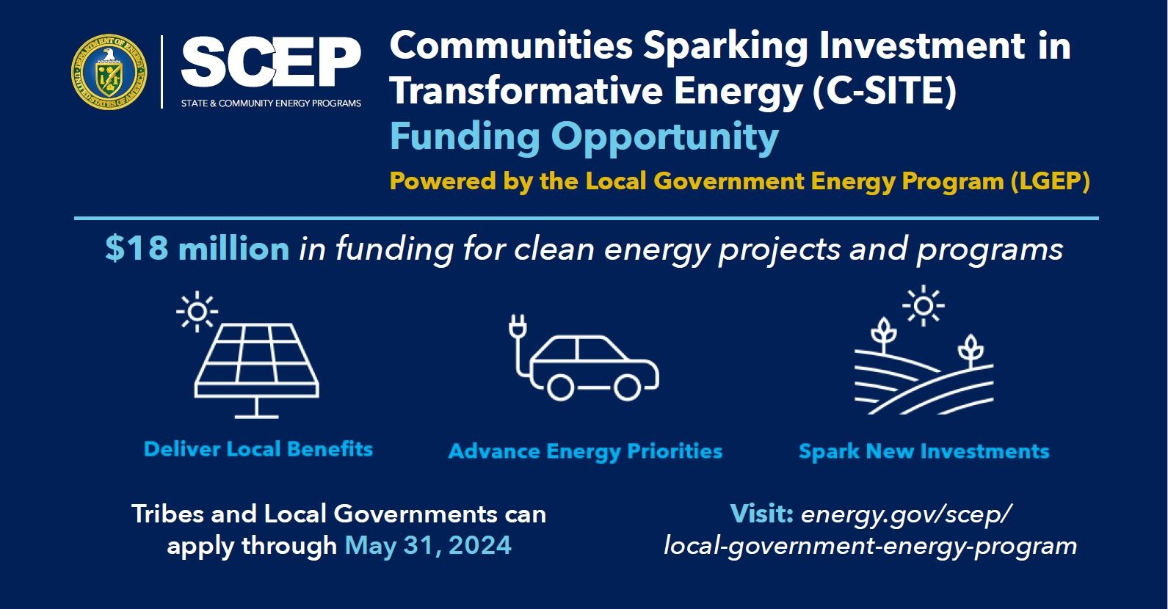
Introducing C-SITE!

Slide 9




Program Goals
Deliver direct local community benefits of clean energy, such as reduced energy costs and improved air quality, through implementation of community-led energy projects or programs
Spark additional investments in communities that create long-term local economic development opportunities and support community revitalization
Advance community-identified energy priorities and right to self-determination
Build local capacity and partnerships in local governments and Tribes

Slide 10

C-SITE Award Structure Overview
Up to 20 competitive awards of approx. $900,000 to $3.6M per award.
Grant period: 12-36 months
Customized technical assistance from experts, including peer exchanges
Community Energy Fellow, optional on-site or virtual capacity to support program implementation for up to 18 months
Eligible Entities
Tribes and Local Governments, representing:
disadvantaged communities
energy communities
small to medium-sized jurisdictions

Slide 11
Topic Area: Transformative Energy Implementation
Projects may range in geographic scopes and technology areas including, but not limited to:
  building efficiency and/or electrification,
  electric transportation,
  microgrid development and deployment,
  renewable energy,
  resilience hubs, and
  workforce development
Seeking High Impact Projects and Programs
Have pre-existing community and decision-maker buy-in, and benefit disadvantaged communities
Demonstrate commitment to meaningful community engagement
Build on existing community assets, or turn liabilities into assets
Attract additional investments to complete, sustain, or scale implementation and impact
Create economic and community revitalization opportunities
Community-identified priorities such as found in:
  Tribal strategic plans
  local government climate action plans,
  regional electrification plans,
  utility community benefit programs,
  long-range transportation or housing plans,
  Previous DOE supported efforts
  …and more!
Notes:
DOES NOT HAVE TO COME FROM THESE, COULD BE FOUND HERE

Slide 12




Possible Project Examples
Illustrations of potential projects funded through this award may include:
Energy efficiency upgrades and on-site battery storage for a community resilience hub/s located in a disadvantaged community.
Tribal partner-owned solar plus storage microgrid independent power project providing power to remote households.
Municipally-owned utility-scale solar photovoltaic (PV) installation on reclaimed industrial land accessing relevant tax credits.
Downtown revitalization led by public/private partnership creating energy efficient buildings primed for reuse for business or community use.
Electric vehicle ride-sharing program aimed at serving low-income residents to increase mobility and access to economic opportunities.

Slide 13
Applications Specifically Not of Interest
Applications that fall outside the technical parameters specified in Section I.A. and I.B.
Applications for proposed technologies that are not based on sound scientific principles (e.g., violates the laws of thermodynamics).
Applications for which the prime applicant is not an eligible applicant, as described in Section III.i.
  Entities not eligible as prime applicants, but can be subrecipients include but are not limited to
Applications for projects in visioning and planning stages rather than implementation stage.
Projects in visioning and planning stages are strongly encouraged to explore additional Technical Assistance (TA) offerings and capacity-building strategies through SCEP.
Nonprofit Organizations
Academic and/or research institutions, Colleges and Universities
For-profit entities​
National laboratories​
States

Slide 14



Eligibility
Federally Recognized Indian Tribe and Local Governments representing AT LEAST ONE of the following:
Disadvantaged Communities (DACs)
Energy Communities
Small and Medium-Sized Jurisdictions
Community encompasses census tract/s that meet the thresholds for at least one of the categories of burden through Climate and Economic Justice Screening Tool (CEJST), OR
US territory or federally recognized Indian Tribe
A “brownfield site”
A “metropolitan statistical area (MSA)” or “non-MSA” with
  0.17% or greater direct employment or 25% or greater local tax revenues from the extraction, processing, transport, or storage of coal, oil, or natural gas; AND
  an unemployment rate at or above the national average unemployment rate for the previous year
A census tract containing a coal mine closed after 1999 or a coal-fired electricity generating unit retired after 2009
“Small” jurisdictions: under 100,000 people
“Medium” jurisdictions: under 250,000 people
¹ Climate & Economic Justice Screening Tool (geoplatform.gov)
² IRA Energy Community Tax Credit Bonus (doe.gov);
Treasury Notice-2023-29 (irs.gov)

Slide 15
How is “local government” defined in this FOA?
Local Government: For the purposes of this FOA, ‘local governments’ are defined as jurisdictions that include, but are not limited to, ANY of the following:
Cities, towns, and villages;
Counties, including on behalf of unincorporated communities, as well as special districts and joint powers authorities;
Municipally or Tribally-owned utilities;
Metropolitan planning organizations, regional planning organizations; and
Councils of governments.

Slide 16
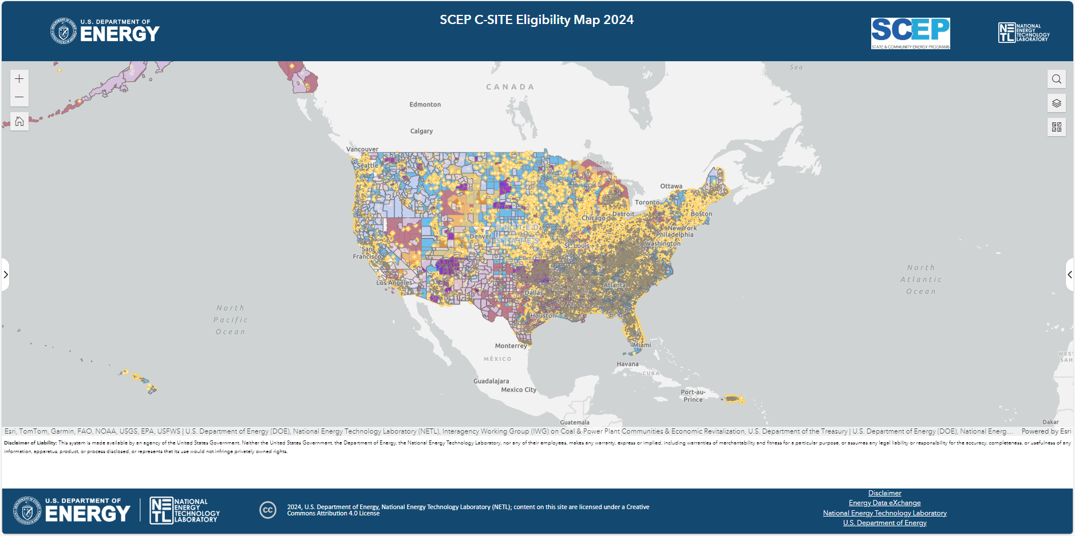
Eligibility Map
This web map provides an illustrative view of communities eligible for C-SITE.
Eligible Applicants: Tribes and local govts representing
disadvantaged communities OR
energy communities OR
small- and medium-sized jurisdictions
NOTE: If your community is not adequately reflected in this map, please state why you are eligible in your application.

Slide 17


Cost Share
Cost share requirement for this FOA is reduced to 5%.
May be met through:
  staff time,
  municipal or Tribal budgets,
  philanthropic funds, or
  other contributions from a third-party entity to support project implementation or increase impact.
Must come from non-federal sources, unless otherwise allowed by law
May be met through the contribution of in-kind services that advance the proposed project.

Slide 18


Technical Assistance
Customized Technical Assistance (TA)
Comprehensive TA provided by technical experts.
  60 – 80 hours of expert access
Peer Exchange
Awardees will have the opportunity to participate in peer exchanges to share ideas, wins, and obstacles.
Community Energy Fellow
Awardees will have the opportunity to host a Community Energy Fellow.
  Provide optional on-site or virtual capacity for up to 18 months
  Support the implementation of the awarded project or program or additional clean energy plans.

Slide 19
Application Review Criteria

Slide 20
Technical Review Criteria
Criterion 1: Community Need, Impact, and Replicability (30%)
Extent to which proposed project:
  addresses community-identified energy needs and priorities and delivers clean energy projects and programs.
  can spur local economic development or community revitalization, utilize existing community assets or transform liabilities into assets, and spark additional investments.
  demonstrates a new approach for a specific community and/or serves as a model approach for other communities to replicate.

Slide 21
Technical Review Criteria
Criterion 2: Community Support, Engagement, and Benefits (30%)
Extent to which proposed project:
  Has broad public support from communities most directly impacted by proposed project, demonstrated through meaningful community engagement (planned or already conducted), as well as support from relevant decision-makers.
  will benefit local workers and provide tangible benefits to residents, as demonstrated through workforce agreements; workforce strategies, commitments, and protections; reduced energy costs; improved air quality; and improved quality of life.
  demonstrates meaningful commitment to diversity, equity, inclusion, and accessibility (DEIA) objectives into the project; labor and stakeholder engagement; and delivery of benefits to disadvantaged communities, aligned with the Justice40 Initiative.

Slide 22
Technical Review Criteria
Criterion 3: Partnerships and Project Feasibility (40%)
Extent to which proposed project:
  the applicant (and proposed subrecipients and/or partners, if relevant) demonstrates relevant skills and ability to succeed, including grant management experience, project management experience, technical expertise, facilitation and convening experience, and community trust
  provides an effective strategy to meet community-identified needs, address key challenges, and provide a strong plan to measure outcomes.
  is technically feasible, inclusive of reasonable budget and spend plan within the established timeline.
  will build organizational and/or staff capacity to support further advancement of clean energy opportunities, the community’s participation in the clean energy economy, and/or right to self-determination

Slide 23
Program Policy Factors
In addition to the Application Criteria, the Selection Official may consider Program Policy Factors:
  Diversity of eligible communities across the portfolio of projects selected for this FOA, including disadvantaged communities, energy communities, federally recognized Indian Tribes, and small and medium-sized jurisdictions.
  Diversity of geographic distribution, approach, or technology when compared to existing DOE portfolio and other projects selected from this FOA (e.g. rural, suburban, urban).
  The degree to which the proposal serves high need communities, including energy burdened-households, communities at risk for disconnections and shutoffs, communities heavily burdened as documented through CEJST, and/or Tribal communities
  Extent to which proposals include Tribes and Tribal perspectives.
  Extent to which proposals include robust community engagement and community decision-making power, demonstrated through partnerships with community-based organizations and other local community perspectives.
  Alignment with administration priorities, as demonstrated through specific strategies to enhance job quality and workforce continuity; diversity, equity, inclusion, and accessibility; and the Justice40 Initiative.
  The degree to which the proposed project incorporates applicant or team members from Minority Serving Institutions (e.g., Historically Black Colleges and Universities (HBCUs)/Other Minority Serving Institutions); and partnerships with Minority Business Enterprises, Minority Owned Businesses, Woman Owned Businesses, Veteran Owned Businesses.
  The degree to which the proposed project will employ procurement of U.S. iron, steel, manufactured products, and construction materials

Slide 24
RECAP: Apply to this FOA if...
You are a federally recognized Indian Tribe or local government representing:
  a disadvantaged community OR an energy community OR a small (100,000) – medium (250,000) sized jurisdiction
You have identified a community-led project or program that
  is seeking funding and technical assistance to advance local clean energy priorities
  builds on existing community assets, attracts additional investments, or creates economic and community revitalization opportunities
  provides benefits to residents and workers, such as job opportunities, reduced energy costs, and improved air quality

Slide 25
Application Process

Slide 26






Anticipated Schedule
Process Step | Timeframe
FOA Issue Date: | February 27, 2024
Informational Webinars | March 7, 2024; 2:00 PM ET March 21, 2024; 3:00 PM ET
Submission Deadline | May 31, 2024, 5:00 PM ET
Replies to Reviewer Comments Submission Deadline: | Early July 2024
Expected SCEP Selection Notification Date | August 2024
Expected Timeline for Award Negotiations: | September – December 2024

Slide 27
Topline Information about C-SITE FOA Application
Applications live!
      Application is available on Infrastructure Exchange
      A How to Apply Guide is available on Infrastructure Exchange: Manuals (energy.gov)
Pre-Application Steps:
    Register in Infrastructure Exchange: Funding Opportunity (energy.gov)
    Register in the System for Award Management (SAM) at https://www.sam.gov/ and obtain Unique Entity ID (UEI) which is assigned by SAM (May Take Several Weeks)
    Register in FedConnect, which will allow eligible entities to receive and acknowledge their award, at https://www.fedconnect.net/
    Register in Grants.gov to receive automatic updates when modifications are made to the FOA
Deadlines:
      Submit application to Infrastructure Exchange by 5:00pm ET on May 31, 2024

Slide 28
Application Checklist
Document | Purpose | Required v Optional
Application for Federal Assistance (SF-424) | Standard for federal assistance (funding) | Required
Project Narrative | Primary application document, including budget narrative | Required, but completing provided template is optional
Budget (SF-424a) | Primary budget document with cost categories, including personnel, travel, equipment, indirect costs Indirect Rate Agreement or Rate Proposal (if applicable) | Required
Summary Slide | Brief project summary for public release | Required
Disclosure of Lobbying Activities | Simple standard disclosure form | Required
NOTE: federally funded research & development centers (FFRDCs) will also need to submit
DOE Work Proposal for FFRDC and Authorization from cognizant Contracting Officer for FFRDC

Slide 29
Available Templates & Additional Resources
Visit Infrastructure Exchange for templates of all application materials on the previous slide and additional optional templates
  https://infrastructure-exchange.energy.gov/
Document | Purpose | Required v Optional
Community Engagement Plan | Detailed template for extended information on community engagement | Optional (Project Narrative asks basic questions)
Community Benefit Plan | Detailed template for extended information on community benefit plan | Optional (Project Narrative asks basic questions)

Slide 30
Application Materials

Slide 31
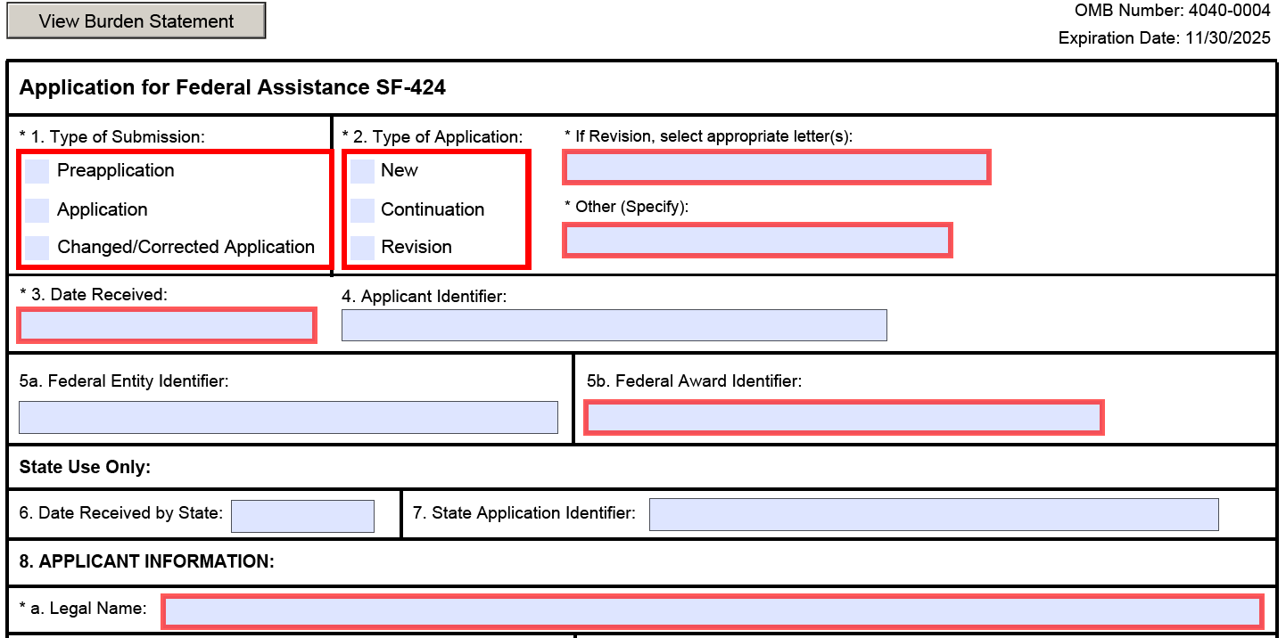
Application for Federal Assistance (SF-424)

Slide 32
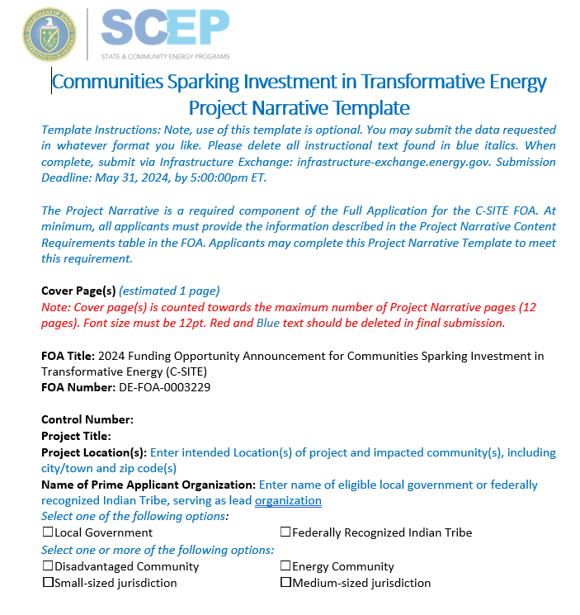
Project Narrative

Slide 33
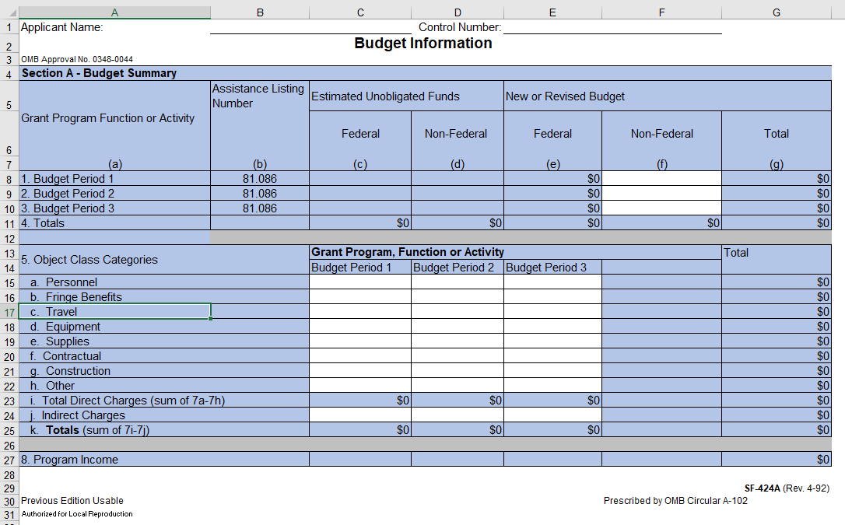
Budget Information (SF-424a)

Slide 34
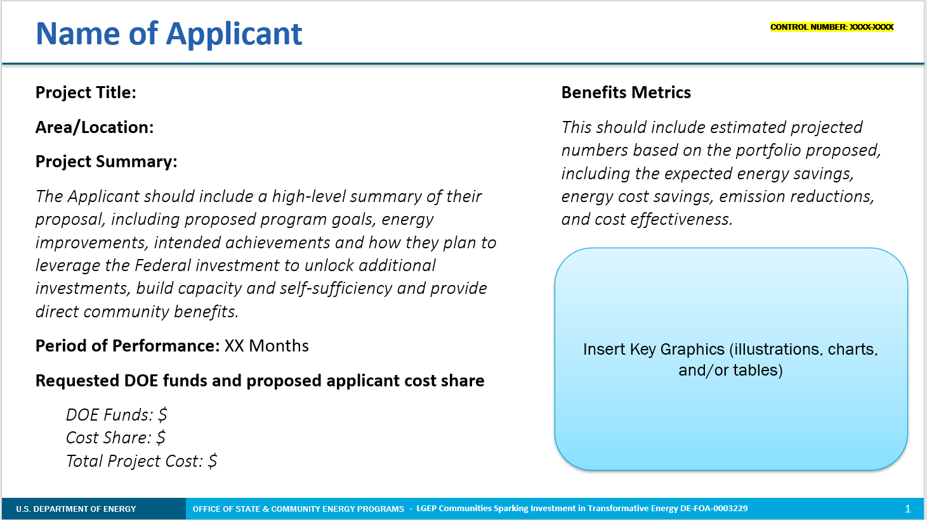
Summary Slide

Slide 35
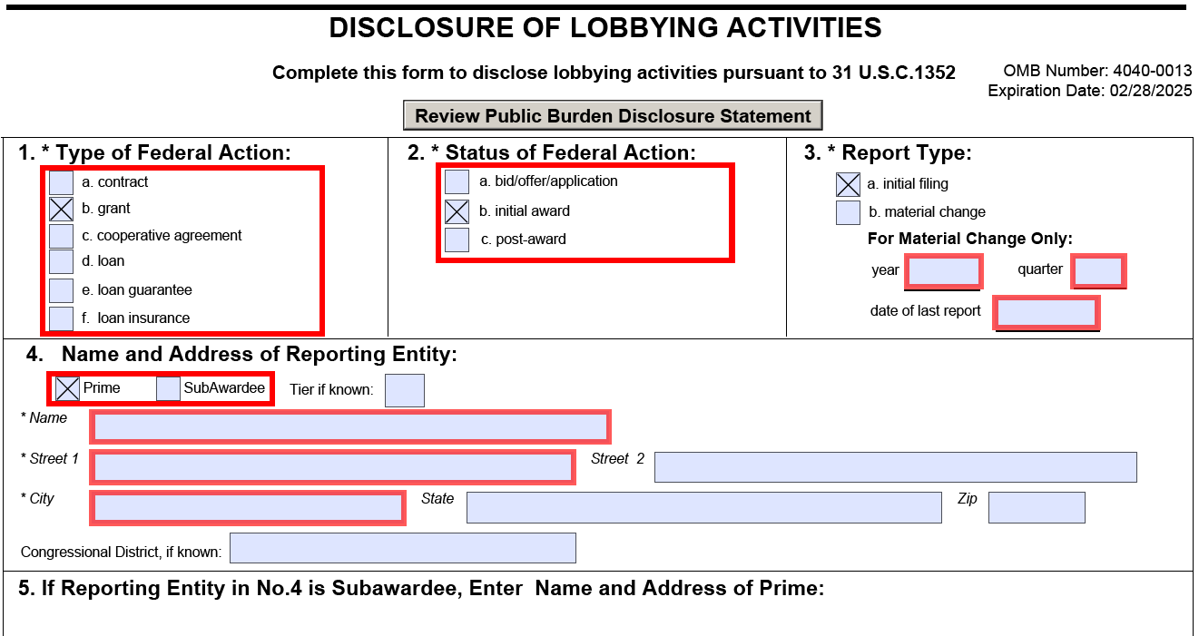
Disclosure of Lobbying Activities (SFLLL)

Slide 36
Infrastructure Exchange

Slide 37
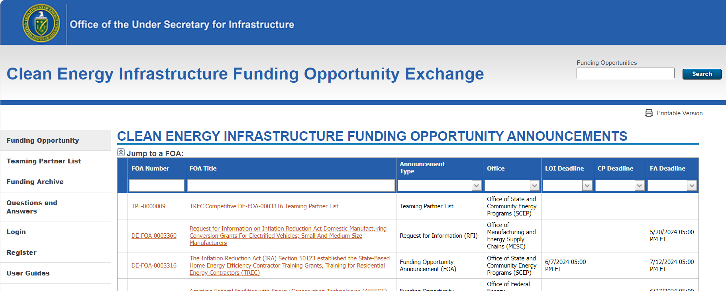
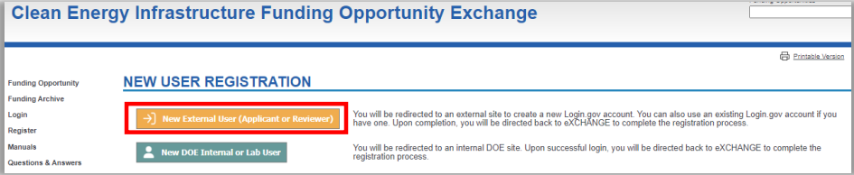
Infrastructure Exchange - New User Registration/Login
Infrastructure eXCHANGE home page
(https://infrastructure-exchange.energy.gov/)

Slide 38
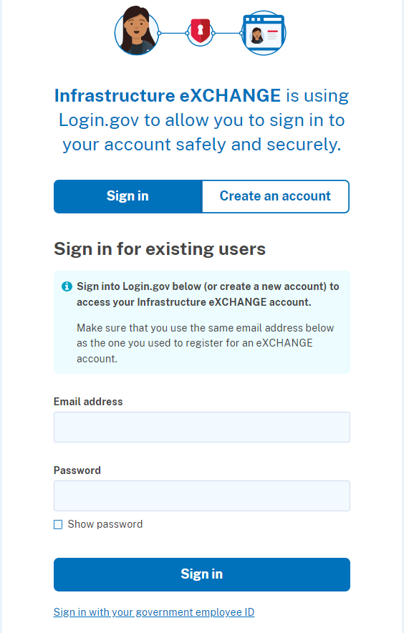
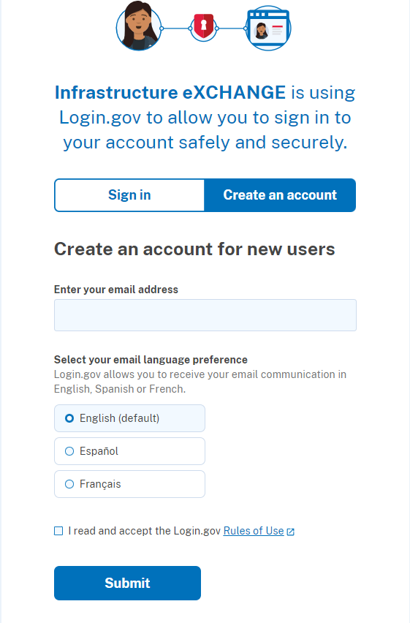
Infrastructure Exchange - New User Registration/Login
Login.gov account holders can sign in using the same account information.
If you are new to Login.gov you will need to create an account.

Slide 39
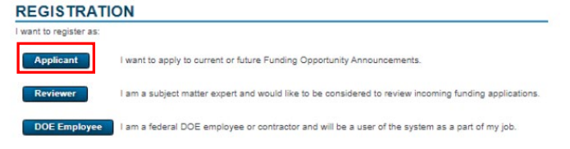
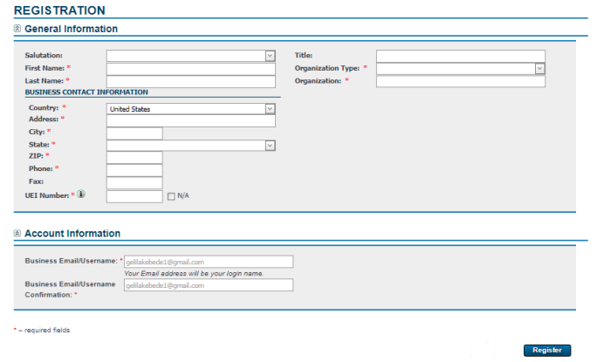
Infrastructure Exchange - New User Registration/Login
After you log in you will automatically be brough to the Registration page.
You must select Applicant to be Registered in the system correctly.

Slide 40
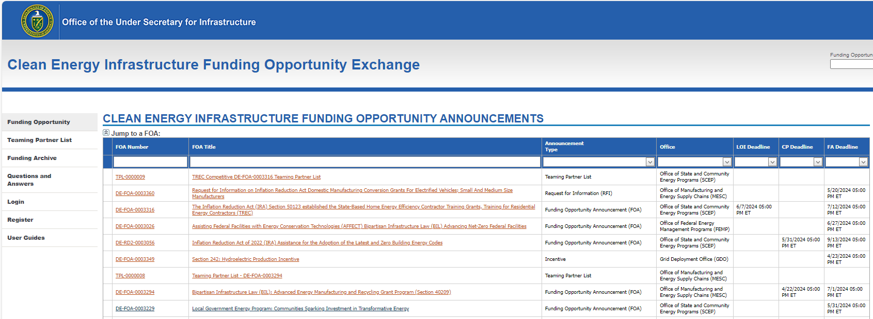
Infrastructure Exchange - How to Apply

Slide 41
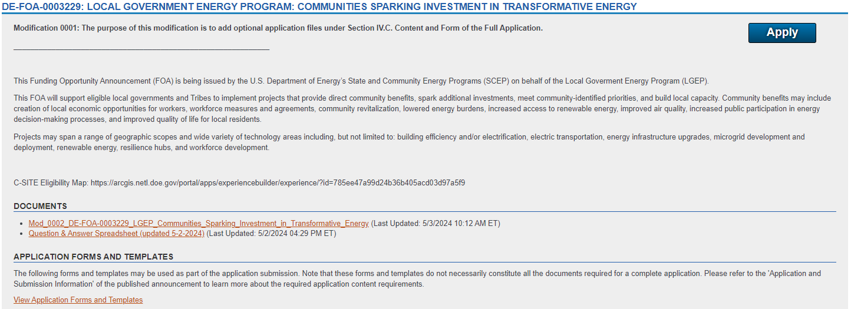
Infrastructure Exchange - How to Apply

Slide 42
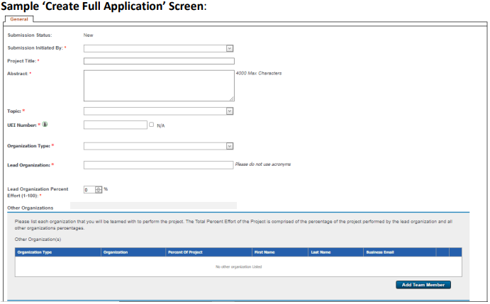
Infrastructure Exchange - How to Apply
You will be asked to provide some general information about your project and the Project Leads/Principal Investigator (PI).
More information on Infrastructure Exchange and How to Apply here (https://infrastructure-exchange.energy.gov/Manuals.aspx)

Slide 43
FAQs

Slide 44
FAQs: General
Is DOE eligible for BIA’s 477 Program?
  DOE is now an eligible agency for Bureau of Indian Affairs’ (BIA) 477 Program: if awarded, a Tribe may apply to integrate funding into their 477 program or plan. 477 funds are legally non-federal funds and therefore can meet federal cost-share requirements.
Does this FOA include a Cost Share Requirement?
  DOE reduced the cost-share requirement for this funding announcement to 5%, which can include staff time and in-kind services to advance the proposal or project. For more information on cost share, please reference Cost Share sections of the FOA and Appendix B in the FOA. Please note that cost share should be incurred during proposed period of performance.

Slide 45
FAQs: General
Is NEPA required for this FOA?
Yes!
However, to streamline the NEPA review process, a list of Allowable Activities has been developed and added to section VI.B.vi of the FOA. These activities do not require further NEPA review (unless otherwise specified). Any proposed activities that fit within the Topic Area but that do not fall within the NEPA Allowable Activities will require additional NEPA review, if selected.
Does DOE provide application support?
No.
While DOE cannot support applicants with grant application materials, DOE has provided templates to make it easier for you to apply, and we encourage you to seek out assistance through other entities, such as nonprofits or regional programs like the EPA & DOE Thriving Communities Technical Assistance Centers (TCTACs).

Slide 46
FAQs: Eligibility
What if my Community is not included on the Eligibility Map or is not accurately categorized?
If your community does not appear on the eligibility map provided or is not accurately categorized in your view, please state in your application how and why you think your community should be eligible given the definitions provided within the C-SITE FOA.
Who can be a Subrecipient?
Subrecipients can include, but are not limited to, nonprofit organizations, Tribal Councils, Tribal energy development organizations, academic and/or research institutions, for-profit entities, local and regional planning organizations, philanthropic organizations and businesses.
  Foreign entities are not allowed to be prime or subrecipients under this FOA

Slide 47
FAQs: Eligibility
Do I need to be a disadvantaged community AND an energy community AND a small-to-medium sized jurisdiction to be eligible?
Eligible applicants can represent ANY of the following: disadvantaged community, OR an energy community OR a small-to-medium sized jurisdiction. Please note that the prime recipient must be a federally recognized Indian Tribe or local government.
Does my quasi-government entity qualify?
Please consult our definitions for local government for further detail. We are unable to confirm specific eligibility to applicants or account for all quasi-government entities; if unsure, consider partnering with an eligible entity for this proposal.

Slide 48
FAQs: Application
If an applicant chooses to complete a Community Engagement Plan or Community Benefits Plan, are those embedded in the Project Narrative or submitted as a separate item?
If an applicant elects to use the optional Community Engagement Plan or Community Benefits Plan templates, this should be submitted as a separate application file. Please see FOA Mod 0002 for more information.
How do I get started? Can I talk to program staff about my idea?
Please visit the LGEP program webpage and the FOA on Exchange. The 2-page Executive Summary is a good starting point.
Unfortunately, staff are prohibited from 1-on-1 discussion about the FOA with applicants outside the formal Q&A submission process to LGEP@hq.doe.gov.

Slide 49
FAQs: Payment & Costs
Is payment only through reimbursement? Is advance payment available?
See the FAQ Document, Part I of Question 2 regarding Pre-Award costs. If selected to receive an award, payment procedures will be defined in the award special terms and conditions.
See IV.I.x. Invoice Review and Approval for more information on what may be required for requests for reimbursement.
Is there a maximum funding amount for infrastructure or equipment pertaining to clean energy or clean transportation?
No.
There is not a ceiling on equipment or infrastructure costs. Please reference FOA sections on Allowable Costs and relevant Uniform Guidance sections regarding real property and equipment purchases (not for-profit non-federal entities: 2 CFR 200.310, 200.311, 200.313, and 200.316; for-profit entities: 2 CFR 910.360).

Slide 50
Next Steps & Reminders
Look at LGEP program webpage for more resources
Check the C-SITE eligibility map
  Note: communities not reflected are encouraged to apply and describe eligibility in application
Register and view materials on Infrastructure Exchange
Read the FOA, including the Executive Summary
Submit application materials via Infrastructure Exchange
  Due date: Friday 5/31/24 at 5:00:00 pm ET
Questions?
  Email LGEP@hq.doe.gov
  Visit energy.gov/scep/local-government-energy-program

Slide 51
Thank you!

