Slide 1






Local Government Energy Program:
Communities Sparking Investment in Transformative Energy
(C-SITE)
Funding Opportunity
Informational Webinars
March 7, 2024
March 21, 2024

Slide 2

Welcome
This webinar is being recorded and will be published on Infrastructure eXCHANGE and program websites.
Please note that video and audio capability has been disabled for attendees.
There will be no live Q&A during today’s webinar.
For questions, please use the Q&A feature or email LGEP@hq.doe.gov - all questions and answers will be posted to the Q&A Spreadsheet on the program website.
A copy of today’s slides will be posted on the program website and Infrastructure eXCHANGE within 2-3 business days of the webinar.

Slide 3
Disclaimer
This presentation summarizes the contents of Funding Opportunity Announcement (FOA) DE-FOA-0003229. No new information other than that provided in the FOA will be discussed in the webinar.
If there are any inconsistencies between the FOA and this presentation, or statements from DOE personnel, the FOA is considered the controlling document. Applicants should rely on the FOA language and seek clarification by submitting a question to LGEP@hq.doe.gov

Slide 4

What We’ll Discuss Today
Funding Opportunity Background
Award Structure
Eligibility
Application Process, Materials, & Criteria
Frequently Asked Questions
Next Steps

Slide 5






Whole Greater than Sum of its Parts
SCEP’s Mission is to partner with State, Local, and Tribal governments and community organizations to catalyze local economic development and job creation through equitable, clean energy solutions.
SCEP does this through the management and oversight of $16 billion in formula grants, competitive grant awards, consumer rebate grants, and technical assistance.
Prioritize Justice40 Initiative
Deploy clean energy technologies
Catalyze local economic development
Create
jobs and increase hiring
Avoid pollution through place-based strategies
Reduce energy costs

Slide 6

28+ Programs Coming Out of SCEP
$3.5B for
Weatherization Assistance Program
$260M for Building Efficiency Workforce Training
$750M for
State Energy Program & Revolving Loan Fund
$500M for
Energy Efficiency & Renewable Energy in Public Schools
$100M for
Energy
Future
Grants
$50M for Energy Efficiency for Non-Profits
$550M for
Energy Efficiency & Conservation Block Grants Program
$1B for
Energy Codes Technical Assistance
$8.8B for Home Energy Rebates

Slide 7




Local Government Energy Program (LGEP)
Established in FY22 as a permanent annual program to support transformative clean energy programs in communities
  Provide competitive awards, on-site capacity, peer exchanges, and technical assistance
  Advance energy efficiency adoption, building and vehicle electrification, grid modernization, distributed electricity generation, and workforce development at the local level

Slide 8
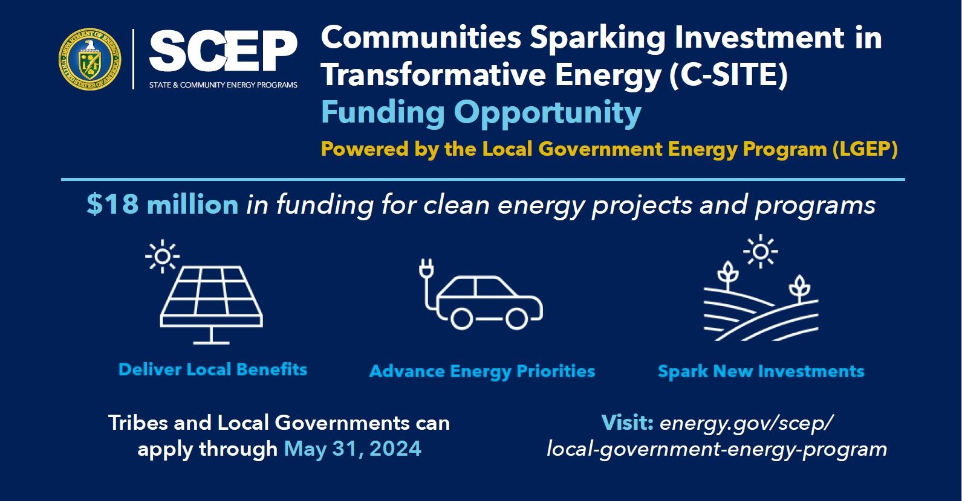
Introducing C-SITE!

Slide 9




Program Goals
Deliver direct local community benefits of clean energy, such as reduced energy costs and improved air quality, through implementation of community-led energy projects or programs
Spark additional investments in communities that create long-term local economic development opportunities and support community revitalization
Advance community-identified energy priorities and right to self-determination
Build local capacity and partnerships in local governments and Tribes

Slide 10

C-SITE Award Structure Overview
Up to 20 competitive awards of approx. $900,000 to $3.6M per award.
Grant period: 12-36 months
Customized technical assistance from experts, including peer exchanges
Community Energy Fellow, optional on-site or virtual capacity to support program implementation for up to 18 months
Eligible Entities
Tribes and Local Governments, representing:
disadvantaged communities
energy communities
small to medium-sized jurisdictions

Slide 11
Topic Area: Transformative Energy Implementation
Projects may range in geographic scopes and technology areas including, but not limited to:
  building efficiency and/or electrification,
  electric transportation,
  microgrid development and deployment,
  renewable energy,
  resilience hubs, and
  workforce development
Seeking High Impact Projects and Programs
Have pre-existing community and decision-maker buy-in, and benefit disadvantaged communities
Demonstrate commitment to meaningful community engagement
Build on existing community assets, or turn liabilities into assets
Attract additional investments to complete, sustain, or scale implementation and impact
Create economic and community revitalization opportunities
Community-identified priorities such as found in:
  Tribal strategic plans
  local government climate action plans,
  regional electrification plans,
  utility community benefit programs,
  long-range transportation or housing plans,
  …and more!
Notes:
DOES NOT HAVE TO COME FROM THESE, COULD BE FOUND HERE

Slide 12




Possible Project Examples
Illustrations of potential projects funded through this award may include:
Energy efficiency upgrades and on-site battery storage for a community resilience hub/s located in a disadvantaged community.
Tribal partner-owned solar plus storage microgrid independent power project providing power to remote households.
Municipally-owned utility-scale solar photovoltaic (PV) installation on reclaimed industrial land accessing relevant tax credits.
Downtown revitalization led by public/private partnership creating energy efficient buildings primed for reuse for business or community use.
Electric vehicle ride-sharing program aimed at serving low-income residents to increase mobility and access to economic opportunities.

Slide 13
Applications Specifically Not of Interest
Applications that fall outside the technical parameters specified in Section I.A. and I.B.
Applications for proposed technologies that are not based on sound scientific principles (e.g., violates the laws of thermodynamics).
Applications for which the prime applicant is not an eligible applicant, as described in Section III.i.
  Entities not eligible as prime applicants, but can be subrecipients include but are not limited to
Applications for projects in visioning and planning stages rather than implementation stage.
Projects in visioning and planning stages are strongly encouraged to explore additional Technical Assistance (TA) offerings and capacity-building strategies through SCEP.
Nonprofit Organizations
Academic and/or research institutions, Colleges and Universities
For-profit entities​
National laboratories​
States

Slide 14



Eligibility
Federally Recognized Indian Tribe and Local Governments representing any of the following
Disadvantaged Communities (DACs)
Energy Communities
Small and Medium-Sized Jurisdictions
Community encompasses census tract/s that meet the thresholds for at least one of the categories of burden through Climate and Economic Justice Screening Tool (CEJST), OR
US territory or federally recognized Indian Tribe
A “brownfield site”
A “metropolitan statistical area (MSA)” or “non-MSA” with
  0.17% or greater direct employment or 25% or greater local tax revenues from the extraction, processing, transport, or storage of coal, oil, or natural gas; AND
  an unemployment rate at or above the national average unemployment rate for the previous year
A census tract containing a coal mine closed after 1999 or a coal-fired electricity generating unit retired after 2009
“Small” jurisdictions: under 100,000 people
“Medium” jurisdictions: under 250,000 people
¹ Climate & Economic Justice Screening Tool (geoplatform.gov)
² IRA Energy Community Tax Credit Bonus (doe.gov);
Treasury Notice-2023-29 (irs.gov)

Slide 15
How is “local government” defined in this FOA?
Local Government: For the purposes of this FOA, ‘local governments’ are defined as jurisdictions that include, but are not limited to, ANY of the following:
Cities, towns, and villages;
Counties, including on behalf of unincorporated communities, as well as special districts and joint powers authorities;
Municipally or Tribally-owned utilities;
Metropolitan planning organizations, regional planning organizations; and
Councils of governments.

Slide 16
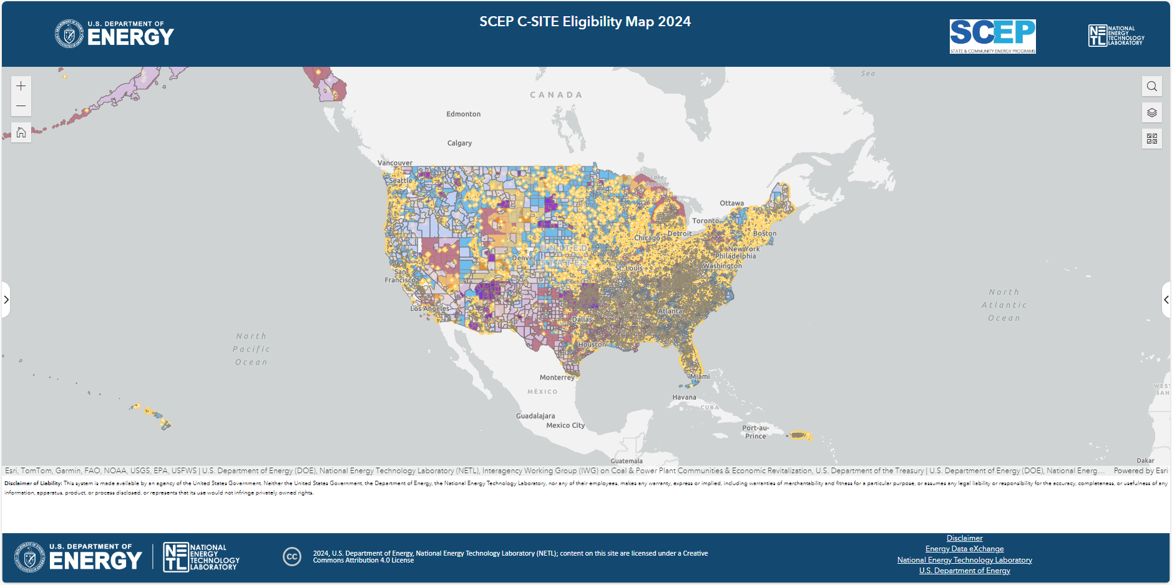
Eligibility Map
This web map provides an illustrative view of communities eligible for the C-SITE FOA
Eligible applicants include federally recognized Indian Tribes, disadvantaged communities, energy communities, and small- and medium-sized jurisdictions.
If your community is not adequately reflected in this map, please state why you are eligible for C-SITE funding in your application.

Slide 17


Cost Share
Cost share requirement for this FOA is reduced to 5%.
May be met through:
  staff time,
  municipal or Tribal budgets,
  philanthropic funds, or
  other contributions from a third-party entity to support project implementation or increase impact.
Must come from non-federal sources, unless otherwise allowed by law
May be met through the contribution of in-kind services that advance the proposed project.

Slide 18


Technical Assistance
Customized Technical Assistance (TA)
Comprehensive TA provided by DOE experts.
  60 – 80 hours of expert access
Peer Exchange
Awardees will have the opportunity to participate in peer exchanges to share ideas, wins, and obstacles.
Community Energy Fellow
Awardees will have the opportunity to host a Community Energy Fellow.
  Provide optional on-site or virtual capacity for up to 18 months
  Support the implementation of the awarded project or program or additional clean energy plans.

Slide 19
Application Process

Slide 20






Anticipated Schedule
Process Step | Timeframe
FOA Issue Date: | February 27, 2024
Informational Webinars | March 7, 2024; 2:00 PM ET March 21, 2024; 3:00 PM ET
Submission Deadline | May 31, 2024, 5:00 PM ET
Replies to Reviewer Comments Submission Deadline: | Early July 2024
Expected SCEP Selection Notification Date | August 2024
Expected Timeline for Award Negotiations: | September – December 2024

Slide 21
Topline Information about C-SITE FOA Application
Applications now live!
      Application is available on Infrastructure Exchange
      A How to Apply Guide is available on Infrastructure eXCHANGE: Manuals (energy.gov)
Pre-Application Steps:
    Register in Infrastructure eXCHANGE: Funding Opportunity (energy.gov)
    Register in the System for Award Management (SAM) at https://www.sam.gov/ and obtain Unique Entity ID (UEI) which is assigned by SAM (May Take Several Weeks)
    Register in FedConnect, which will allow eligible entities to receive and acknowledge their award, at https://www.fedconnect.net/
    Register in Grants.gov to receive automatic updates when Amendments are made to the FOA
Deadlines:
      Submit application to Infrastructure eXCHANGE by 5:00pm ET on May 31, 2024

Slide 22
Application Materials

Slide 23
Documents Needed to Apply
Application Materials
Application for Federal Funding (SF-424)
Summary Slide
Project Narrative Template
Budget Information (SF-424a)
  Personnel, fringe benefits, travel, equipment, supplies, contractual, other direct costs, indirect costs
  Indirect Rate Agreement or Rate Proposal (if applicable)
Disclosure of Lobbying Activities (SFLLL)
Compliance and Assurances
DOE Work Proposal for FFRDC (if applicable)
Authorization from cognizant Contracting Officer for FFRDC (if applicable)
Templates and Resources
Visit Infrastructure Exchange for all application materials, including the following templates:
  Project Narrative template
  Budget Information template (SF-424a)
Templates within the FOA Appendix (note these are optional templates):
  Community Engagement Plan (Optional)
  Community Benefit Plan (Optional)

Slide 24
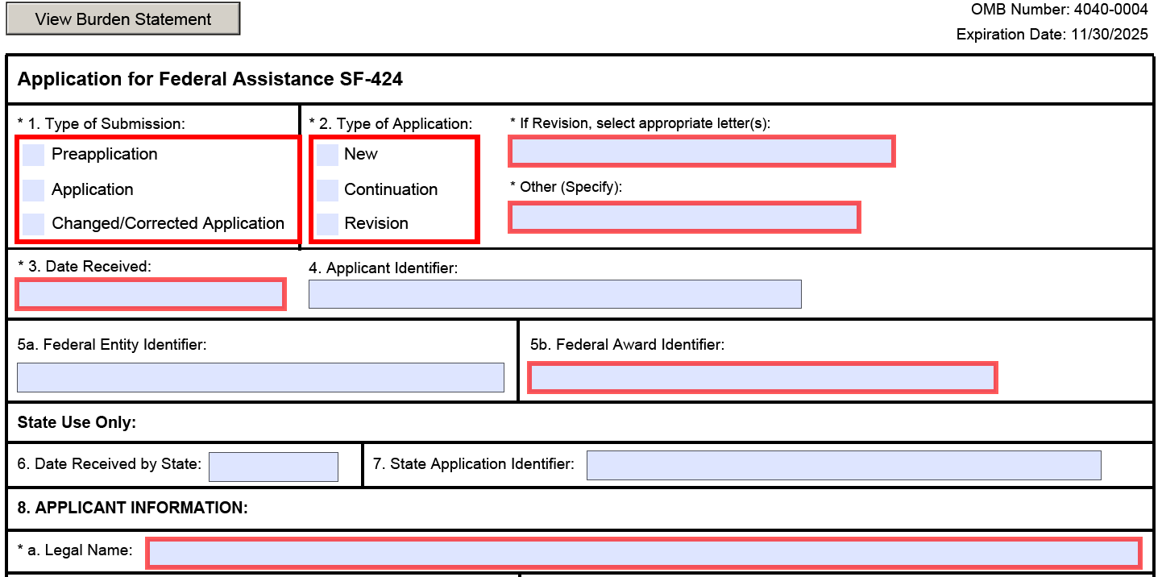
SF-424

Slide 25
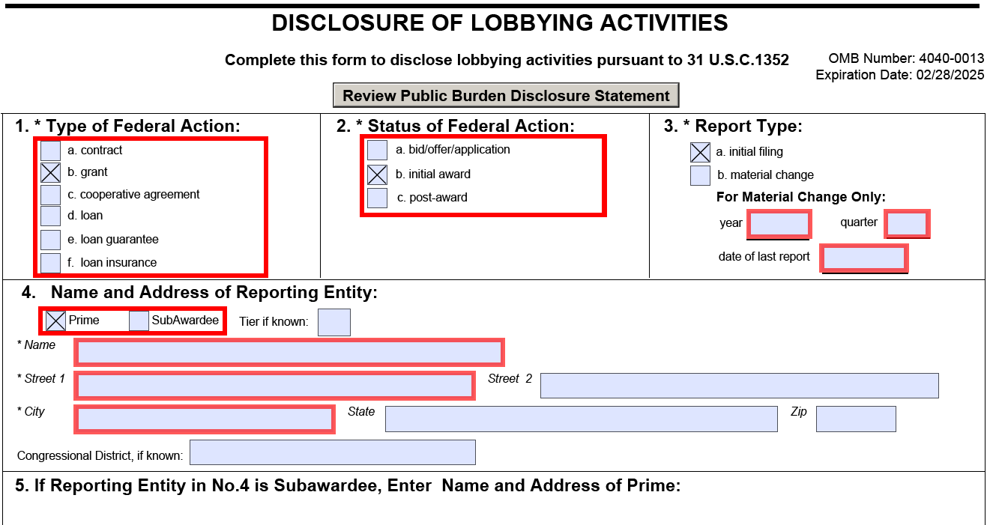
Disclosure of Lobbying Activities (SFLLL)

Slide 26
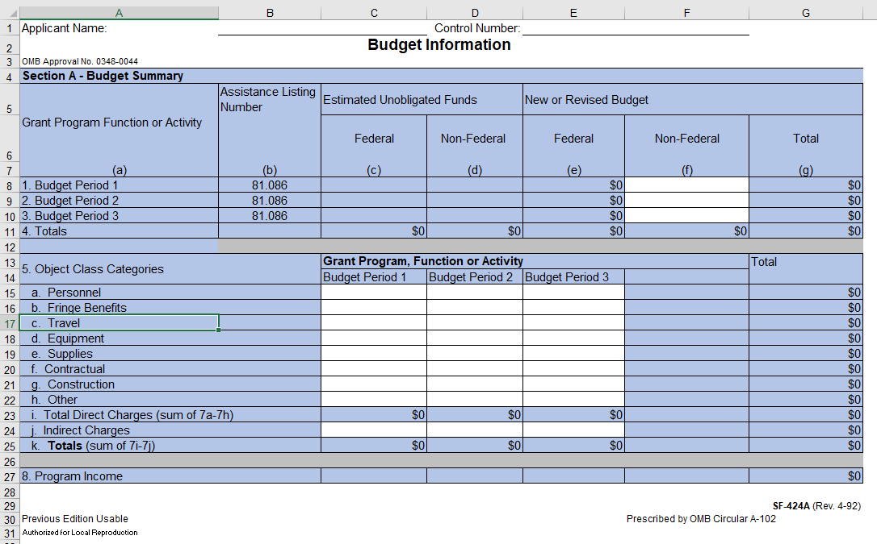
SF-424a Budget Information

Slide 27
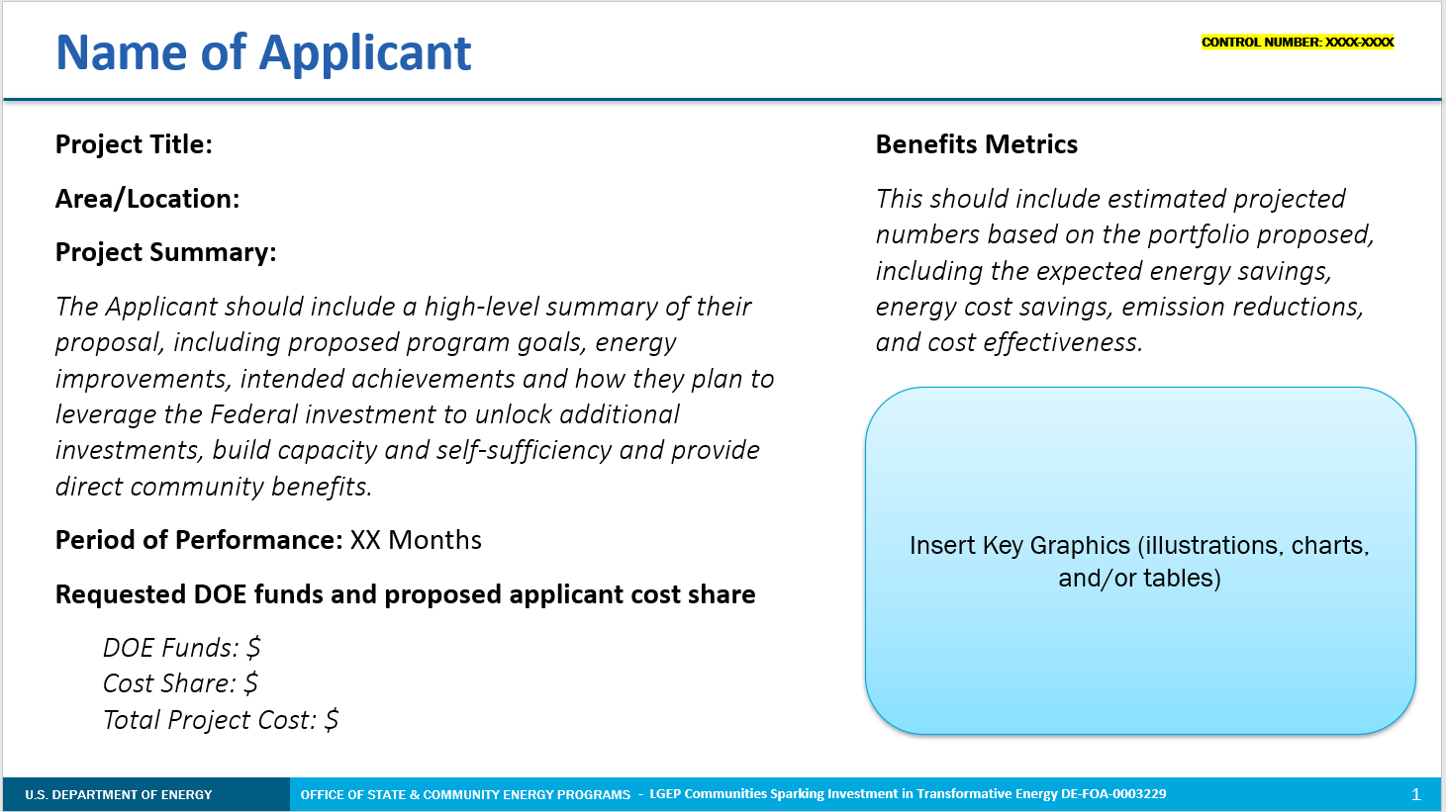
Summary Slide

Slide 28
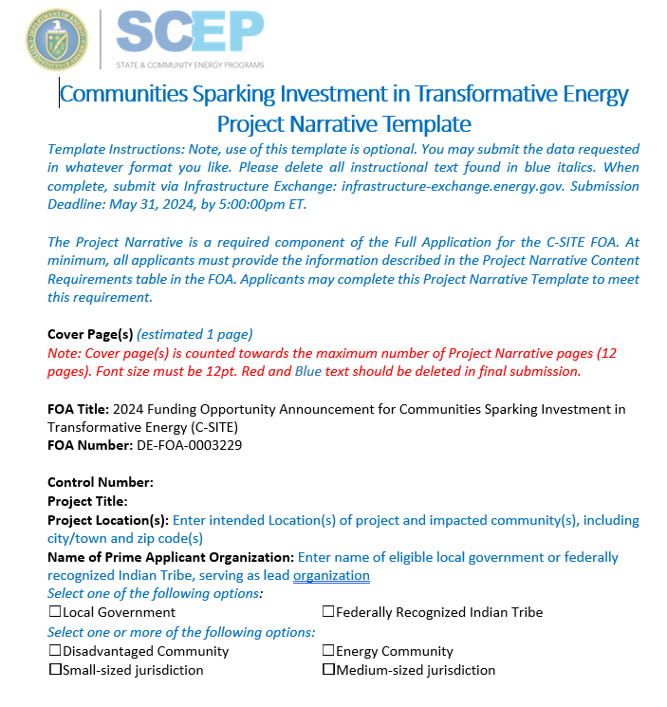
Project Narrative Template

Slide 29
Application Criteria

Slide 30
Technical Review Criteria
Criterion 1: Community Need, Impact, and Replicability (30%)
Extent to which proposed project:
  addresses community-identified energy needs and priorities and delivers clean energy projects and programs.
  can spur local economic development or community revitalization, utilize existing community assets or transform liabilities into assets, and spark additional investments.
  demonstrates a new approach for a specific community and/or serves as a model approach for other communities to replicate.

Slide 31
Technical Review Criteria
Criterion 2: Community Support, Engagement, and Benefits (30%)
Extent to which proposed project:
  Has broad public support from communities most directly impacted by proposed project, demonstrated through meaningful community engagement (planned or already conducted), as well as support from relevant decision-makers.
  will benefit local workers and provide tangible benefits to residents, as demonstrated through workforce agreements; workforce strategies, commitments, and protections; reduced energy costs; improved air quality; and improved quality of life.
  demonstrates meaningful commitment to diversity, equity, inclusion, and accessibility (DEIA) objectives into the project; labor and stakeholder engagement; and delivery of benefits to disadvantaged communities, aligned with the Justice40 Initiative.

Slide 32
Technical Review Criteria
Criterion 3: Partnerships and Project Feasibility (40%)
Extent to which proposed project:
  the applicant (and proposed subrecipients and/or partners, if relevant) demonstrates relevant skills and ability to succeed, including grant management experience, project management experience, technical expertise, facilitation and convening experience, and community trust
  provides an effective strategy to meet community-identified needs, address key challenges, and provide a strong plan to measure outcomes.
  is technically feasible, inclusive of reasonable budget and spend plan within the established timeline.
  will build organizational and/or staff capacity to support further advancement of clean energy opportunities, the community’s participation in the clean energy economy, and/or right to self-determination

Slide 33
Program Policy Factors
In addition to the Application Criteria, the Selection Official may consider Program Policy Factors:
  Diversity of eligible communities across the portfolio of projects selected for this FOA, including disadvantaged communities, energy communities, federally recognized Indian Tribes, and small and medium-sized jurisdictions.
  Diversity of geographic distribution, approach, or technology when compared to existing DOE portfolio and other projects selected from this FOA (e.g. rural, suburban, urban).
  The degree to which the proposal serves high need communities, including energy burdened-households, communities at risk for disconnections and shutoffs, communities heavily burdened as documented through CEJST, and/or Tribal communities
  Extent to which proposals include Tribes and Tribal perspectives.
  Extent to which proposals include robust community engagement and community decision-making power, demonstrated through partnerships with community-based organizations and other local community perspectives.
  Alignment with administration priorities, as demonstrated through specific strategies to enhance job quality and workforce continuity; diversity, equity, inclusion, and accessibility; and the Justice40 Initiative.
  The degree to which the proposed project incorporates applicant or team members from Minority Serving Institutions (e.g., Historically Black Colleges and Universities (HBCUs)/Other Minority Serving Institutions); and partnerships with Minority Business Enterprises, Minority Owned Businesses, Woman Owned Businesses, Veteran Owned Businesses.
  The degree to which the proposed project will employ procurement of U.S. iron, steel, manufactured products, and construction materials

Slide 34
FAQs

Slide 35
FAQs
Does DOE participate in BIA’s 477 Program?
Yes!
  DOE is now an eligible agency for Bureau of Indian Affairs’ (BIA) 477 Program: if awarded, a Tribe may apply to integrate funding into their 477 program or plan. 477 funds are legally non-federal funds and therefore can meet federal cost-share requirements.
Does this FOA include a Cost Share Requirement?
Yes!
  DOE reduced the cost-share requirement for this funding announcement to 5%, which can include staff time and in-kind services to advance the proposal or project. For more information on cost share, please reference Appendix B in the FOA.

Slide 36
FAQs
What if my Community is not included on the Eligibility Map or is not accurately categorized?
If your community does not appear on the eligibility map provided or is not accurately categorized in your view, state in your application how and why you think your community should be eligible given the definitions provided within the C-SITE FOA.
Who can be a Subrecipient?
Subrecipients can include, but are not limited to, nonprofit organizations, Tribal Councils, Tribal energy development organizations, academic and/or research institutions, for-profit entities, local and regional planning organizations, philanthropic organizations and businesses.
  Foreign entities are not allowed to be prime or subrecipients under this FOA

Slide 37
Next Steps
Questions?
  Email LGEP@hq.doe.gov
  Visit energy.gov/scep/local-government-energy-program
  Read the FOA
Join an Informational Webinar:
  Click the “Join” link on the LGEP website to connect to the Microsoft Teams live presentation
  March 21, 2024; 3:00-4:00 pm ET

Slide 38
Thank you!

