Slide 1
2025 Budget Presentation
Department

Slide 2
Who we are
Setting new expectations for the criminal justice system by increasing access to justice, fairness and equity.
Maintaining the highest ethical standards and preserving the rights of victims.

Slide 3
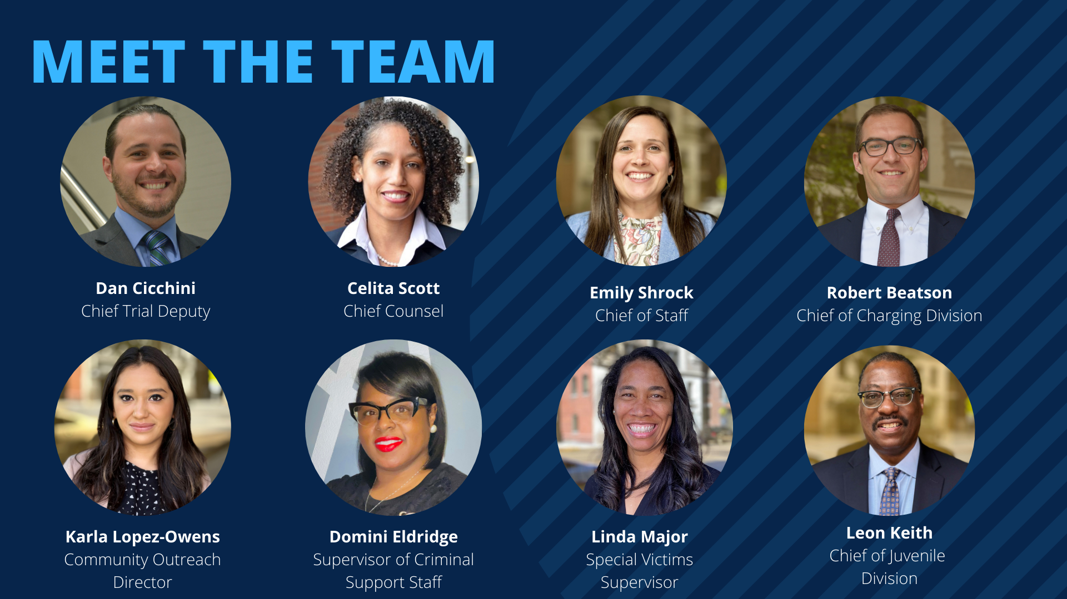

Slide 4
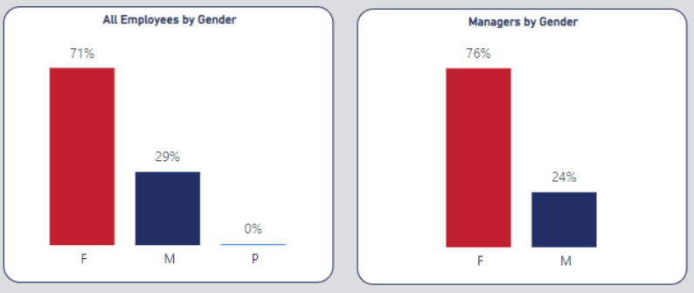
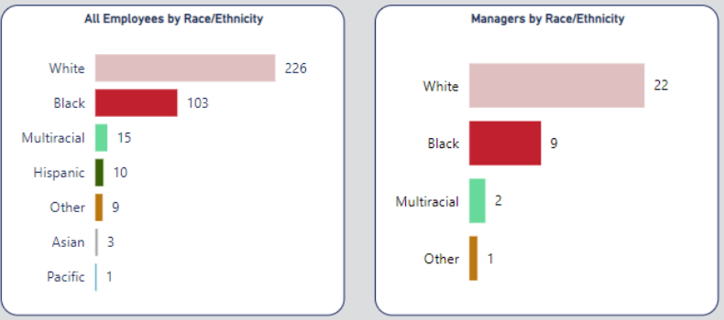
Who we are

Slide 5
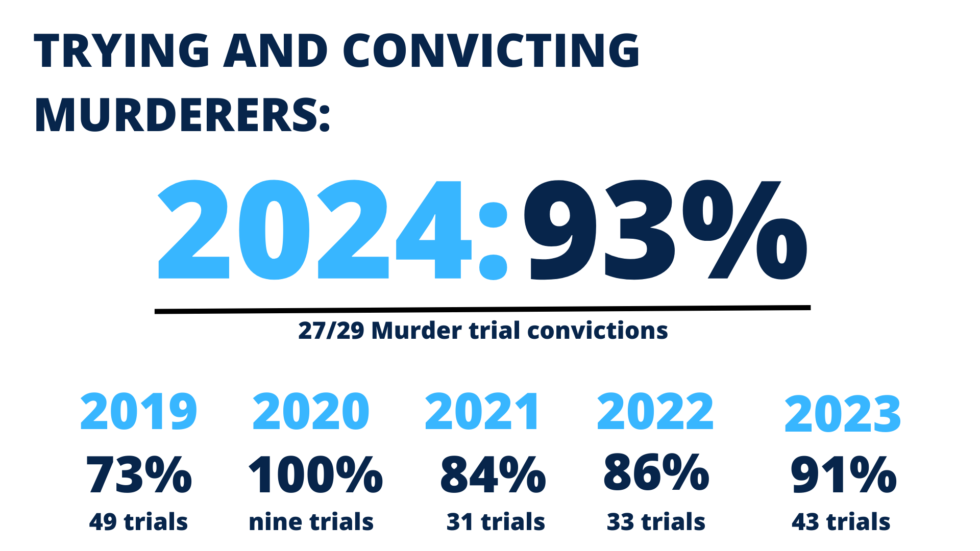

Slide 6
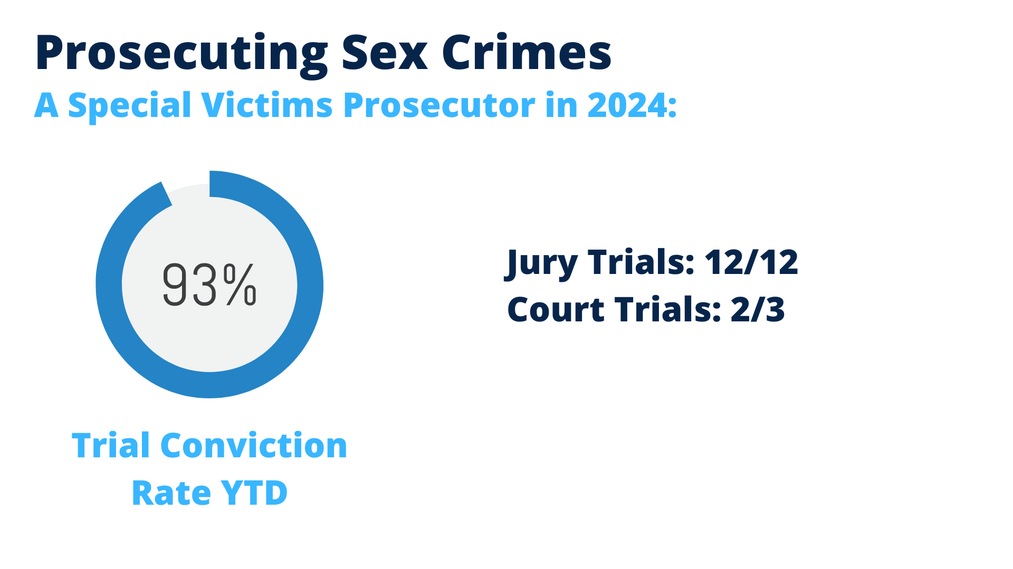

Slide 7
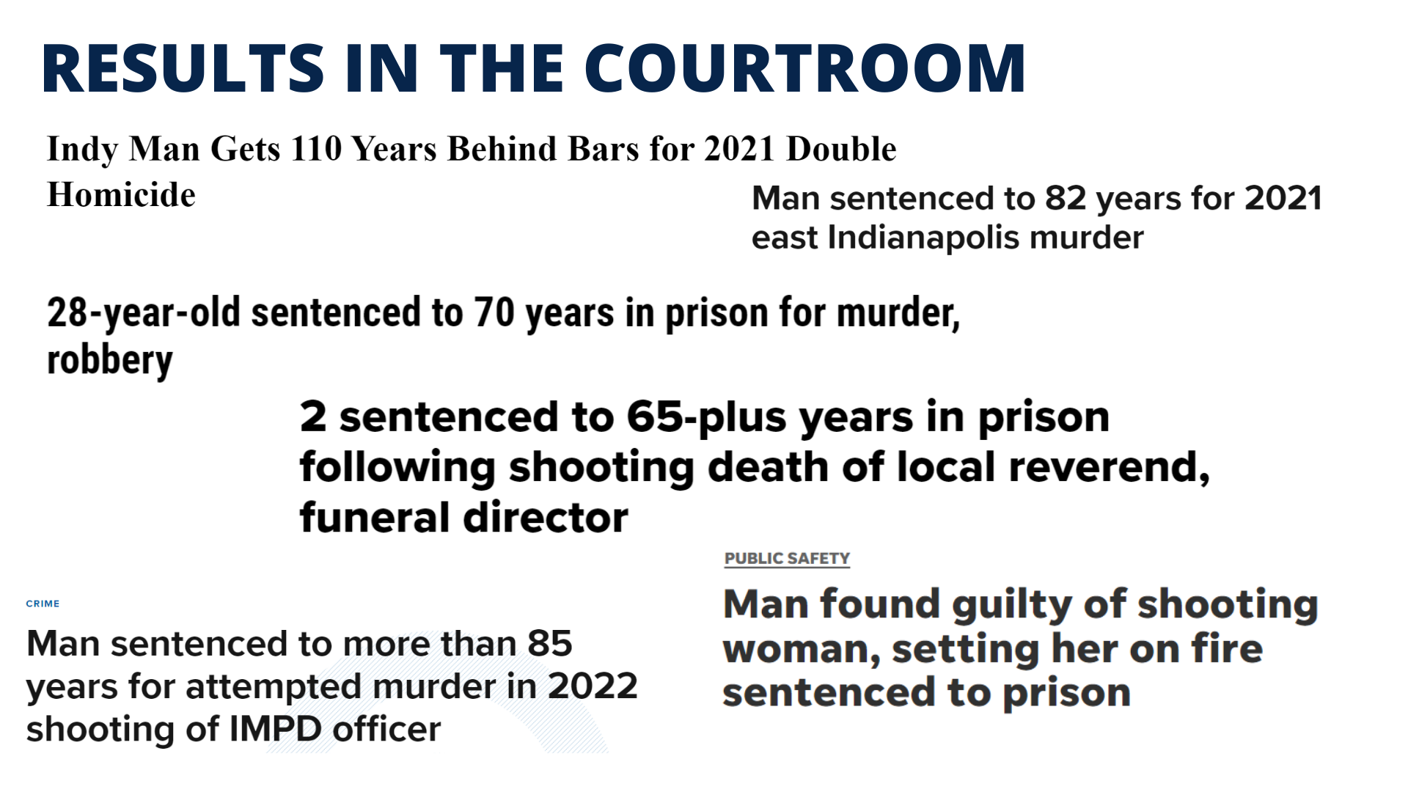

Slide 8


Slide 9
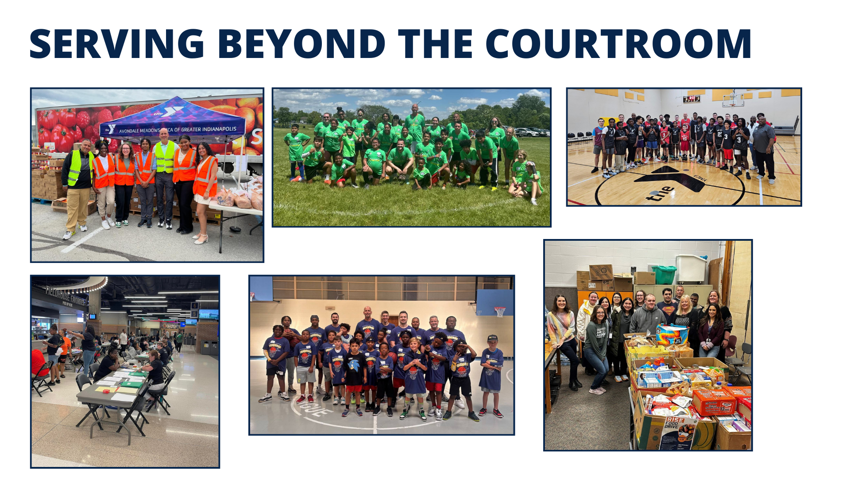

Slide 10
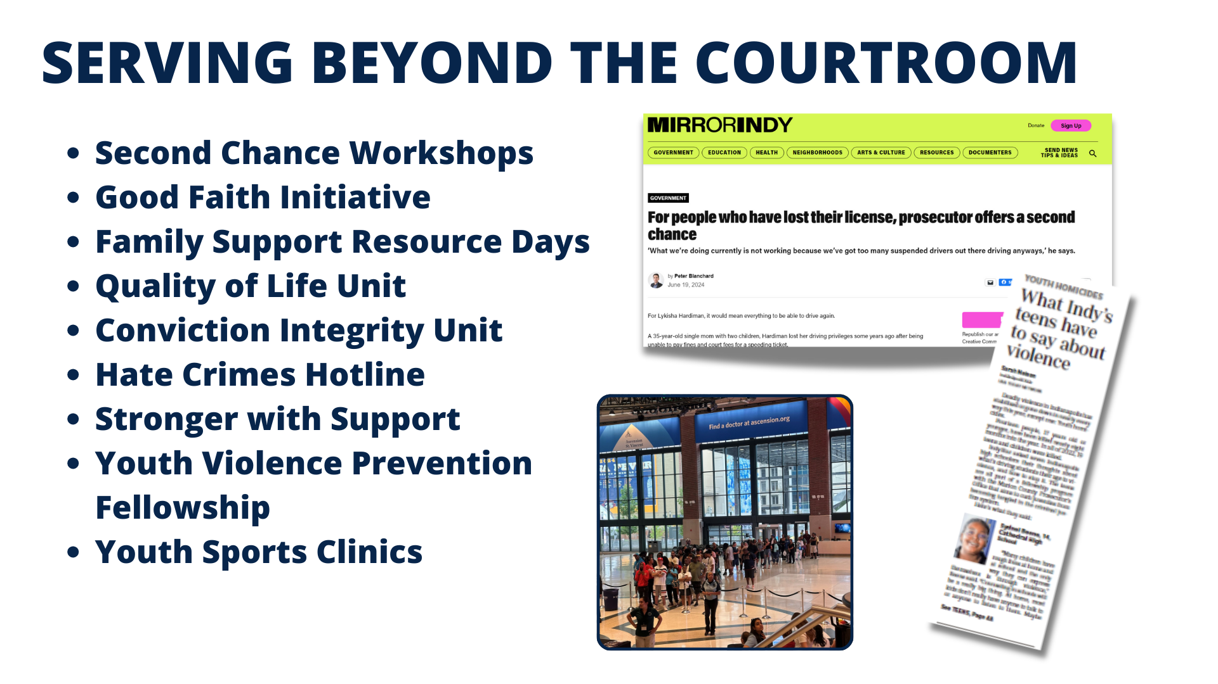

Slide 11
Marion County Prosecutor’s Office Criminal Division
2025 Proposed Budget by Fund
County General $ 25,151,127
County Federal Law Enforcement $ 1,468,680
County State Law Enforcement $ 1,371,920
Diversion Fees $ 269,868
Drug Free Community – County $ 40,000
County Public Safety Income Tax $ 2,647,974
Deferral Program Fees $ 700,000
Federal Grants - County $ 1,893,820
State of Indiana Grants – County $ 1,271,513
Marion County Grants - County $ 197,515
TOTAL: $ 35,012,418

Slide 12
Marion County Prosecutor’s Office Criminal Division
2025 Budget by Character
Character 1 | $ 28,367,323
Character 2 | $ 469,668
Character 3 | $ 5,192,949
Character 4 | $ 982,478
TOTAL | $ 35,012,418

Slide 13

Marion County Prosecutor’s Office: Child Support Division

Slide 14
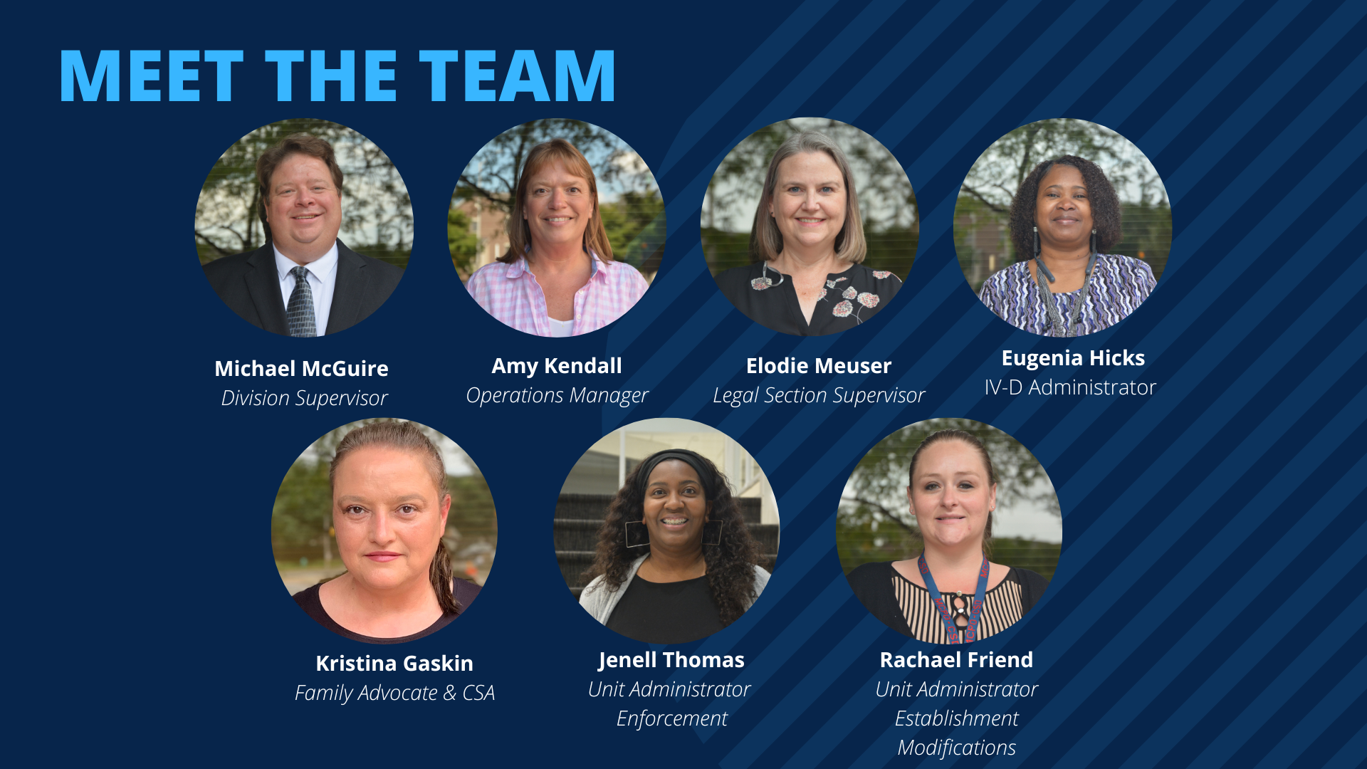

Slide 15
Marion County Prosecutor’s Office
Child Support Division
Division Objectives:
Assist parents in establishing paternity for children born out of wedlock
Assist parents in establishing child support and medical support orders
Assist parents in enforcing child support and medical support orders
Provide assistance for parents in other states

Slide 16
Marion County Prosecutor’s Office Child Support Division
2025 Budget by Character
Character 1 | $ 5,898,566
Character 2 | $ 11,027
Character 3 | $ 1,154,539
Character 4 | $ 8,000
TOTAL | $ 7,072,132

Slide 17
Marion County Prosecutor’s Office Child Support Division
2025 Budget by Fund
State Funding | $ 758,490
Funding of Dept. 31 | $ 4,167,004
County General Fund | $ 2,146,638
Total Budget | $ 7,072,132

Slide 18
MCPO Child Support Division Objectives for 2025
Creating a new mediation program to assist Title IV-D parents in solving IV-D and Family Law issues outside the courtroom
Reaching out to the community to explain our role and improve our services
Continuing our work with non-custodial parents to rescind child support holds on driver’s licenses
Continuing to improve our training process
Continuing the process of preparing employees for new state computer system
Continuing the Good Faith Initiative
Continuing Family Support Community Days

Slide 19
Budgeting for Equity - Successes
Second Chance Workshops
Good Faith Initiative
Stronger With Support
Quality of Life Unit
Grit Into Grace pilot program
Family Resource Days
Parents That Work Program

Slide 20
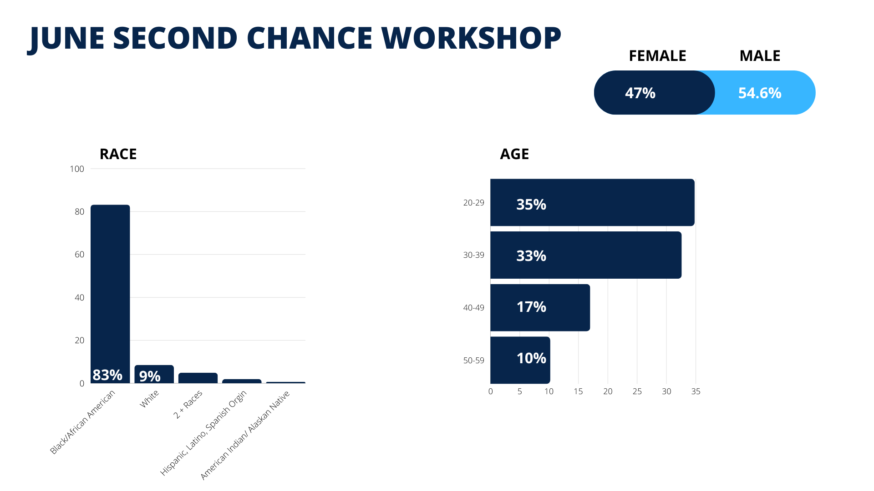
Budgeting for Equity- Population
Notes:
If your agency/department is more internally focused and primarily serves city-county employees rather than the general population such as Audit and Performance or Office of Corporate Counsel, think about the demographics of city-county employees as the population you could be serving.
If your agency/department is community-facing such as Parks, OPHS, DPW or DMD, treat the entire city as the population you could be serving.

Slide 21
Budgeting for Equity – 2025 Budget
In what ways does your department’s overall budget for the next fiscal year advance racial equity? Please articulate:
Expand community-based initiatives
Expanding recruitment
Improve retention
Increase collaboration with community organizations
Notes:
What equity goals has your department identified since the last budget cycle (if applicable)? Have they changed from previous years?
In what ways are you addressing disparities including, but not limited to race, ethnicity, gender, sexual orientation, and ability or disability.
What costs associated with DEI training and professional development are included in this year’s budget proposal?
In addition to your XBE goals, in what other ways is your department advancing equity within our community?
Please identify the specific disparities your department’s efforts are designed to address, including a brief description of the internal data, external data or processes used to identify those disparities and inform future budget decisions.
If applicable, describe how your department is administrating and implementing equitable fines and fees.

Slide 22
Budgeting for Equity – Community Engagement
Anthem, City of Indianapolis - Human Resources, City of Indianapolis - Veteran Services, Marion County Sheriff’s Office, Marion County Youth Violence Prevention Coalition, Firefly Children and Family Alliance, Covering Kids and Families of Health and Hospital, Indiana Diaper Bank, Indy Champions for Domestic Violence Prevention, Pathway to Recover, Shalom Health Care Center, Recycle Force, Keys 2 Work, Marion County Public Health Department Healthy Start, First Student, Trusted Mentors, Southeast Community Service, Reaching Our Brother, Inc., Hope Hustlers, Marion County Public Defender Agency, Ice Miller, Indiana Public Defender Council, Eli Lilly, Indy Bar, Employ Indy, Insurance Assistance- SHIP, Step Up, Gleaners Food Bank, Excel Center, Second Helpings, Lawrence Township Small Claims Court team, Horizon House, AFSCME, Fathers and Families Center, Stop the Violence Indianapolis, Baptist Ministers Alliance, Concerned Clergy, IMA, Voices CORP, Boys & Girls Club, SCRAP, Progress House, Indiana Diaper Bank.

Slide 23
Questions?

