Slide 1
Mayor’s Office for People with Disabilities
Community Conversation:
Pedestrian Safety and Traffic Signals
Notes:
Ellie

Slide 2


Meeting Announcements
2
This meeting is being recorded.
American Sign Language (ASL) and Closed Captioning are being provided.
There will be a time for public comments and questions. If you wish to speak at that time; please raise your hand or use the chat.
We ask that you remain muted throughout the meeting.
Notes:
Ellie

Slide 3
Agenda
3
Welcome from Mayor’s Office for People with Disabilities and the Mayor’s Commission on People with Disabilities
Pedestrian Safety/Traffic Signal Community Conversation with the Philadelphia Streets Department
Questions and Discussion with Community

Slide 4
Statement on the Mayor’s Commission on People with Disabilities
4
The Mayor’s Commission on People with Disabilities (MCPD) conducts systemic advocacy on behalf of Philadelphians with disabilities within City government and the citywide disability community.
The Commission is supported by the Mayor’s Office for People with Disabilities within the Office of Diversity, Equity and Inclusion for the City of Philadelphia.
Making sure that Philadelphians with disabilities are included in all facets of the community.
Notes:
Commissioner

Slide 5

Don’t Forget to Vote in the Primary Election TOMORROW
“Get Up, Get Into It, Get Involved.” - James Brown
Know your rights, including Voters with disabilities may have assistance in casting their ballots from a person of their choice, other than an employer or union official. Voting Rights Act, 52 U.S.C. § 10508
Register to vote!!
    Find Your Polling Place
Report Voting Access Issues to: City Commissioners’ Office
Report issues to the District Attorney’s Election Task Force at 215-686-9641
Concerns can also be directed to 1-877-VOTESPA (1-877-868-3772)

Slide 6
Need Assistance from the Mayor’s Office for People with Disabilities?
6
Residents with disabilities can request a reasonable modification to City programs, services, or activities, submit an ADA grievance, and access additional resources through the Mayor’s Office for People with Disabilities, which is part of the Office of Diversity, Equity and Inclusion for the City of Philadelphia.
ADA Accommodations
ADA Grievances
ADA Requests via email: ADA.Request@Phila.gov
Office Phone: 215-686-2798
Sign up for our mailing list and Sign up for the Mayor’s Engagement mailing list

Slide 7
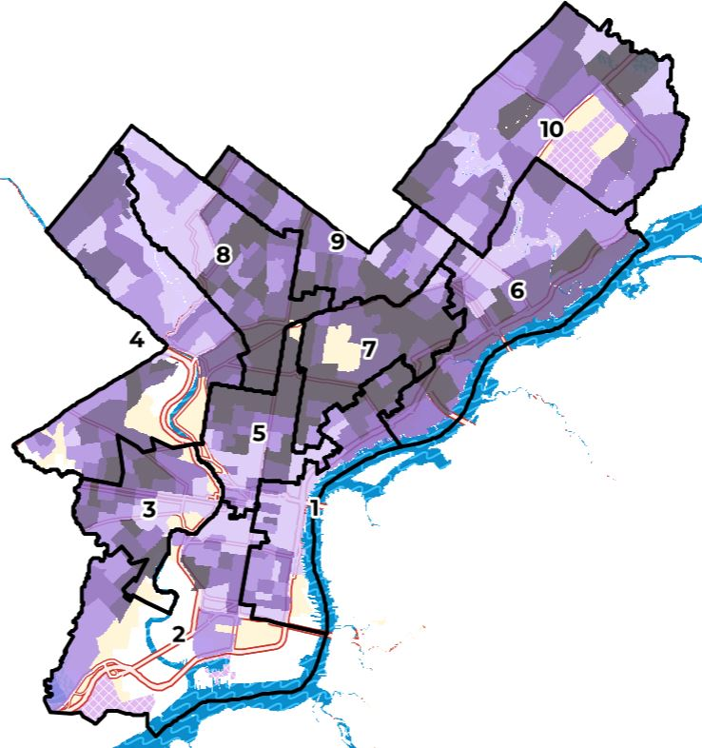
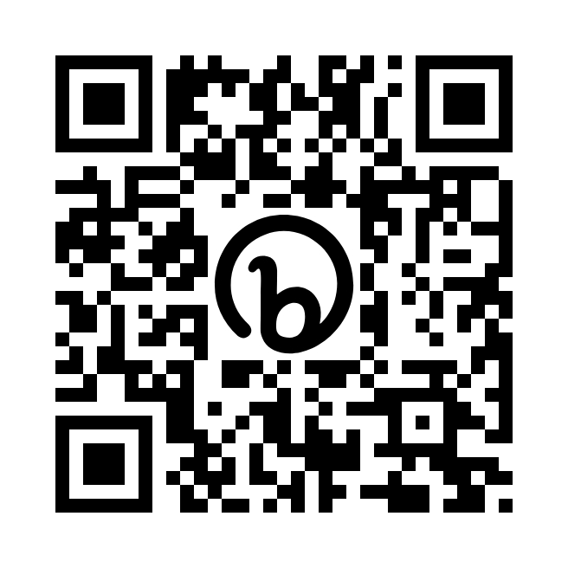
Have you checked out our Disability Characteristics City of Philadelphia Map?
“Representation matters because there is a richness, to disability you are probably not aware of.” –Elsa S. Henry
Resources | Mayor's Office for People with Disabilities | City of Philadelphia

Slide 8
The Disability Characteristics City of Philadelphia Map got an Accessible Upgrade!
Nearly 17 percent and roughly 246,000 Philadelphians are people with disabilities according to the latest American Community Survey Results.
We encourage users to explore the map and find out more about the disability representation in their neighborhood, district, and city.
The map is now considered one of the most accessible data maps in the world!

Slide 9

Today’s Panel on Pedestrian Safety and Traffic Signals
Notes:
Amy

Slide 10

Vision Zero
Vision Zero is dedicated to eliminating traffic deaths on Philadelphia streets.
Their work empowers communities, designs and builds safe streets, promotes safe and healthy modes of transportation, and enacts policies across all sectors and levels of government.
Important Links:
Vision Zero PHL
Vision Zero Annual Report 2023
Vision Zero Capital Plan 2025
Vision Zero: Get Involved!
Traffic Safety Fact Sheets
Complete Streets Projects Transform Traffic Safety

Slide 11

Safety Resources
Important Links:
Pedestrian Safety Action Plan
Feet First Philly
Feet First Philly Pedestrian Advocacy Guide
Safe Routes Philly
Traffic Safety Resources | City of Philadelphia
CHOP | Pedestrian Safety
American Council of the Blind Pedestrian Safety Handbook
TO REPORT AN ISSUE:
Philly311
Philly311 contact center
Calls: The contact center answers calls to 311 from 8 a.m. to 8 p.m., Monday through Friday. If you’re outside of Philadelphia, call (215) 686-8686.
Walk-ins: The Philly311 walk-in center is open from 8 a.m. to 4 p.m., Monday through Friday.

Slide 12

Discussion
Attendees can share their comments and questions with today’s panelists related to Pedestrian Safety and Traffic Signals.
Notes:
Nick

Slide 13
Please Be Mindful
Please keep comments and questions brief and respectful.
Raise your hand to speak.
If on the phone hit *6 to unmute. *9 to raise your hand.
Speakers will be limited to one comment/question but can add to the chat.
If you prefer to submit your comments in the chat, you can do so.
Notes:
Nick

Slide 14

Closing Remarks
Thank you for joining us today for our Community Conversation on
Pedestrian Safety!
Notes:
Sapphire

Slide 15
Questions and Concerns for the Mayor's Office for People with Disabilities
Mayor’s Office for People with Disabilities
Office: Phone: 215-686-2798
ADA Requests: ADA.Request@phila.gov
Adrienne Moore, ADA Director
Adrienne.Ewing@phila.gov
Khalia Jackson,
Constituent Service Administrator
Khalia.Jackson@phila.gov
Julian Gavino, ADA Coordinator
Julian.Gavino@phila.gov
Ellie Spasova, Mayor's Office for People with Disabilities Intern
Elena.Spasova@phila.gov
Sign up for our mailing list today!
Notes:
Sapphire

